Slide 1
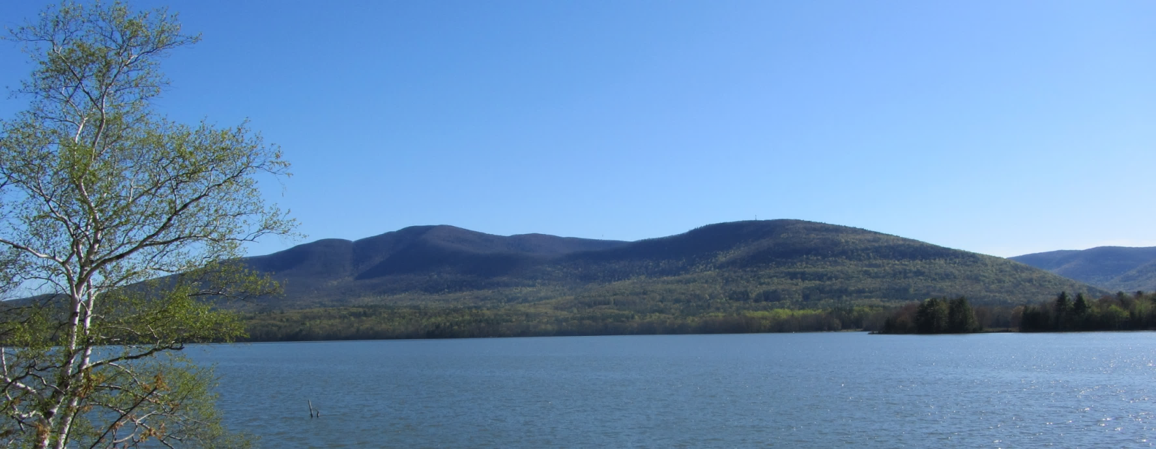

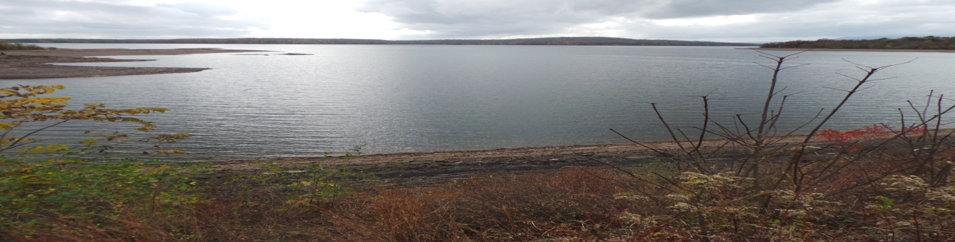
Ulster County Trail Network
Overview and Update
Ulster County Regional Chamber of Commerce
May 23, 2019
Presentation by Chris White
Deputy Director of Planning- Trails Project Manager

Slide 2
Ulster County Trail Network
Ulster County Trails At A Glance
Estimated 400+ miles of recreational trails (hiking, biking, skiing, equestrian, etc.)
Includes approximately 90 + miles of carriage roads (Shawangunk Ridge)
More than 48 miles of multi-use trails currently open to public
An additional 20+ miles of multi- use trail under construction or planning design
http://ulstercountyny.gov/maps/recreation/

Slide 3
Ulster County Trail Projects
Hudson Valley Rail Trail Phase 4
(Empire State Trail Segment)
Town of Lloyd
****
Ashokan Rail Trail
Towns of Hurley and Olive
****
Kingston Rail Trail (“O&W Link Trail”)
City of Kingston, Towns of Hurley and Ulster
****
Ulster County Midtown Linear Park
City of Kingston- Midtown
$23.2 Million Total in Trail Projects
$16.9 Million in Grants Awards (13 Discrete Grants)

Slide 4
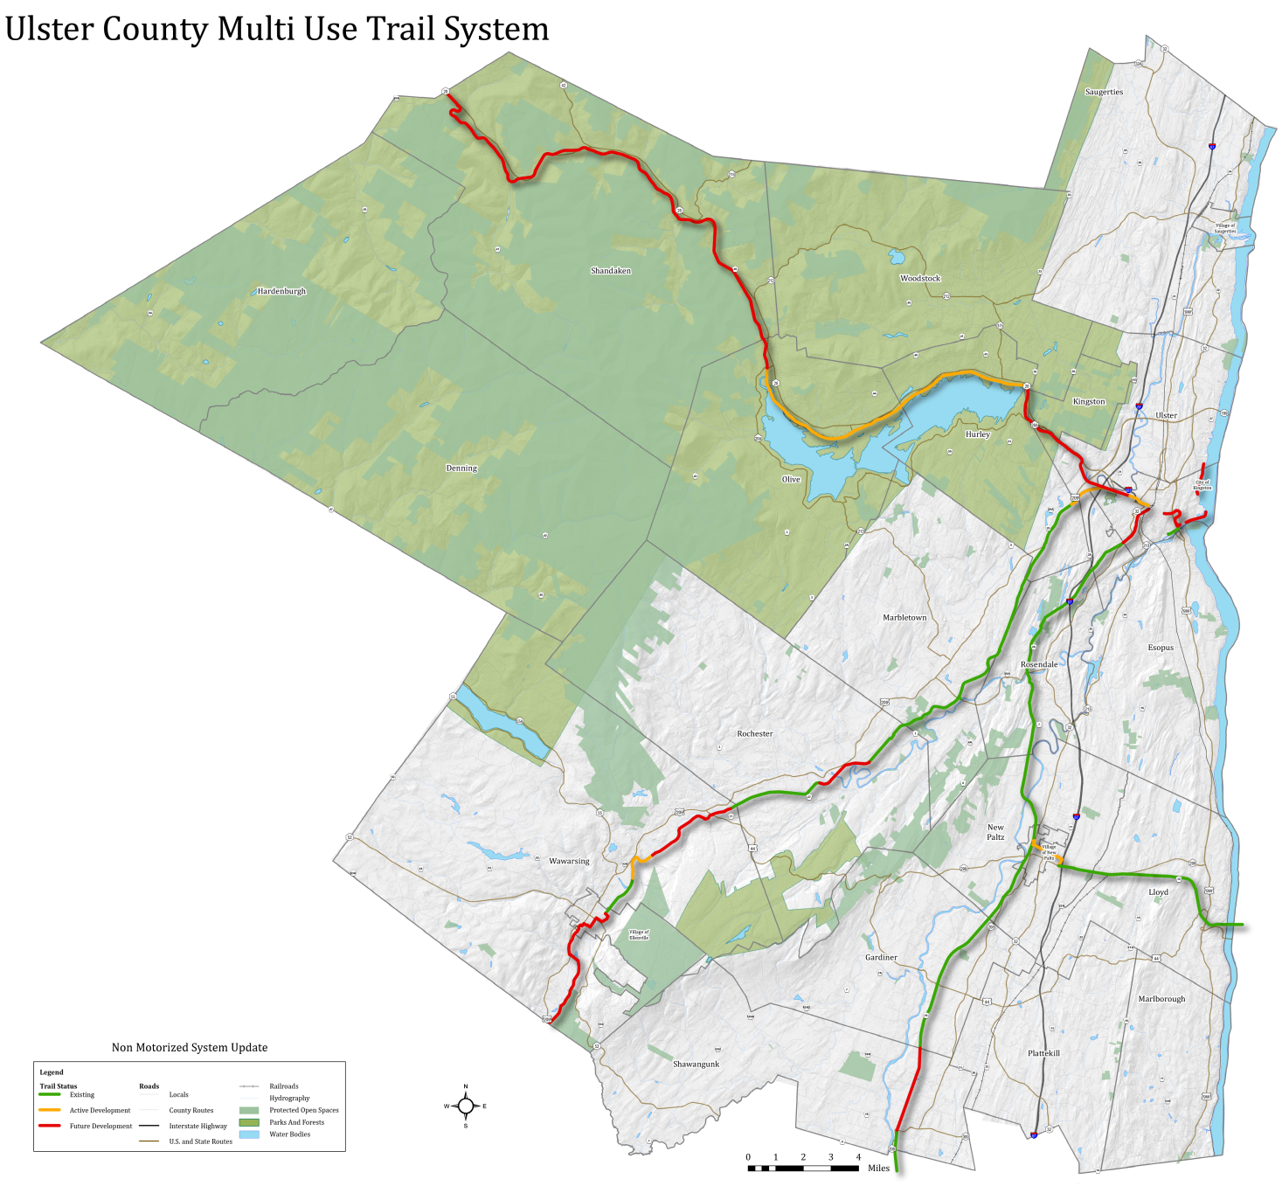
Ulster County Trail Network
Ashokan Rail Trail
11.5 miles- Under Construction
4 Phase Implementation
Midtown Linear Park
0.8- Mile- Design Phase
Kingston
O&W Rail Trail
18+ Miles- Existing
4+ Miles- Pending
Wallkill Valley Rail Trail
(Empire State Trail)
21.5 Miles- Existing
New Paltz
Ellenville
Hudson Valley Rail Trail (Empire State Trail)
7 Miles Trail/ 1.5 Miles Road

Slide 5
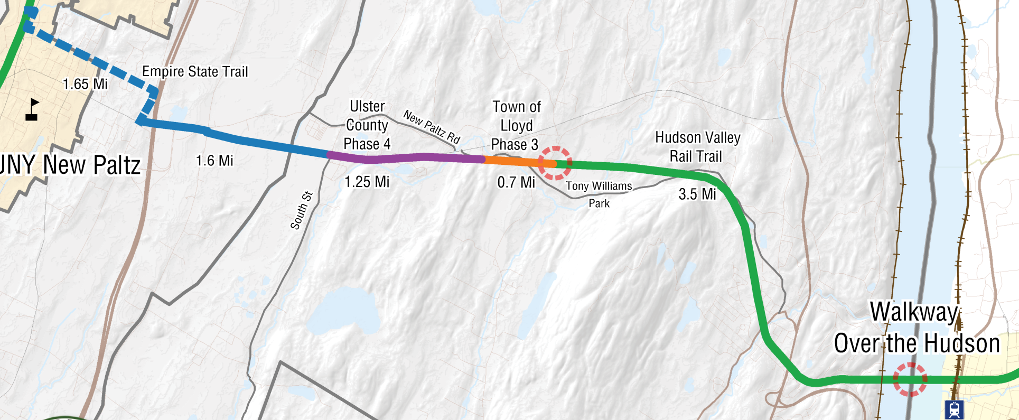
Hudson Valley Rail Trail /
Empire State Trail
Hudson Valley Rail Trail
Towns of Lloyd and New Paltz
5.5 Miles Previously Completed (Paved, 12 Ft. Wide)
Last 3 Miles Now Open/ Completion by Summer 2019

Slide 6
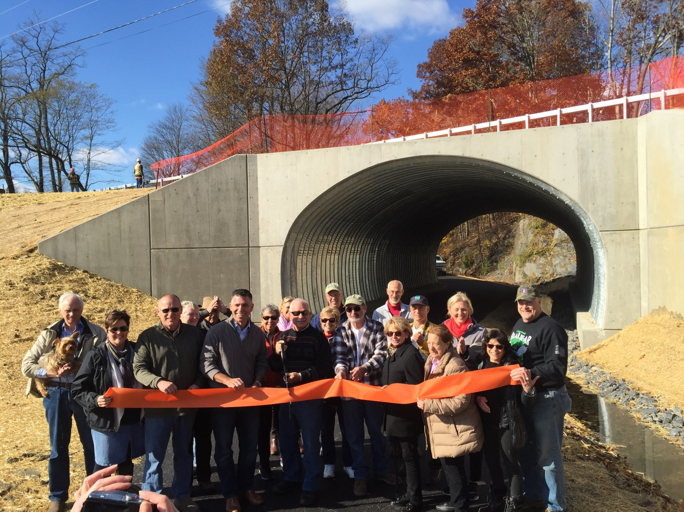
Hudson Valley Rail Trail
Phase 3 Opening: November 8, 2018

Slide 7
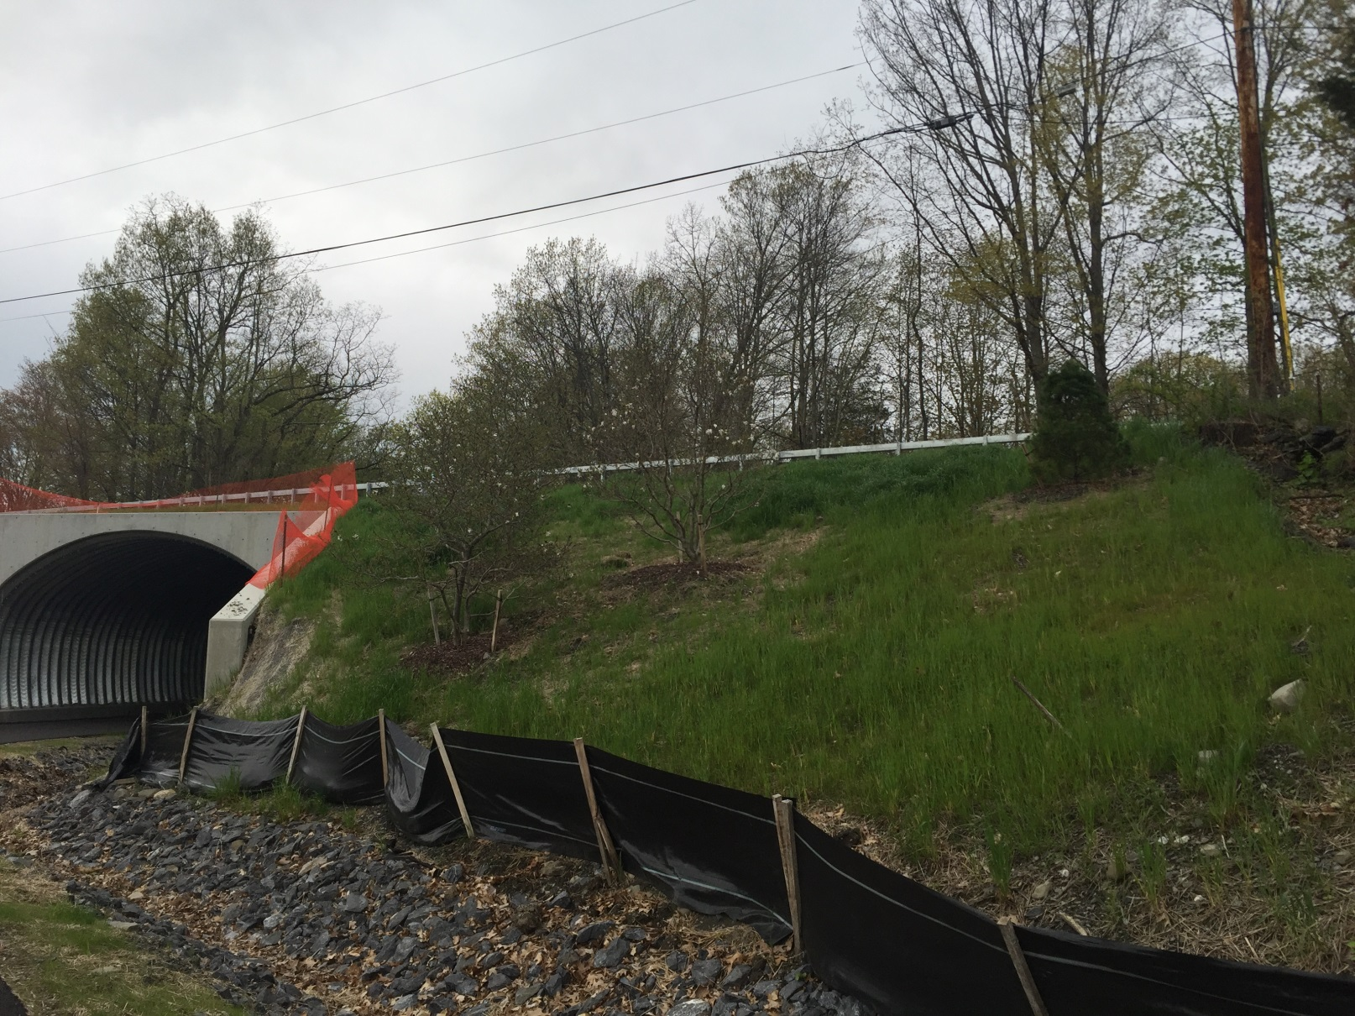
Hudson Valley Rail Trail
Phase 3: Tony Williams Park to New Paltz Road

Slide 8
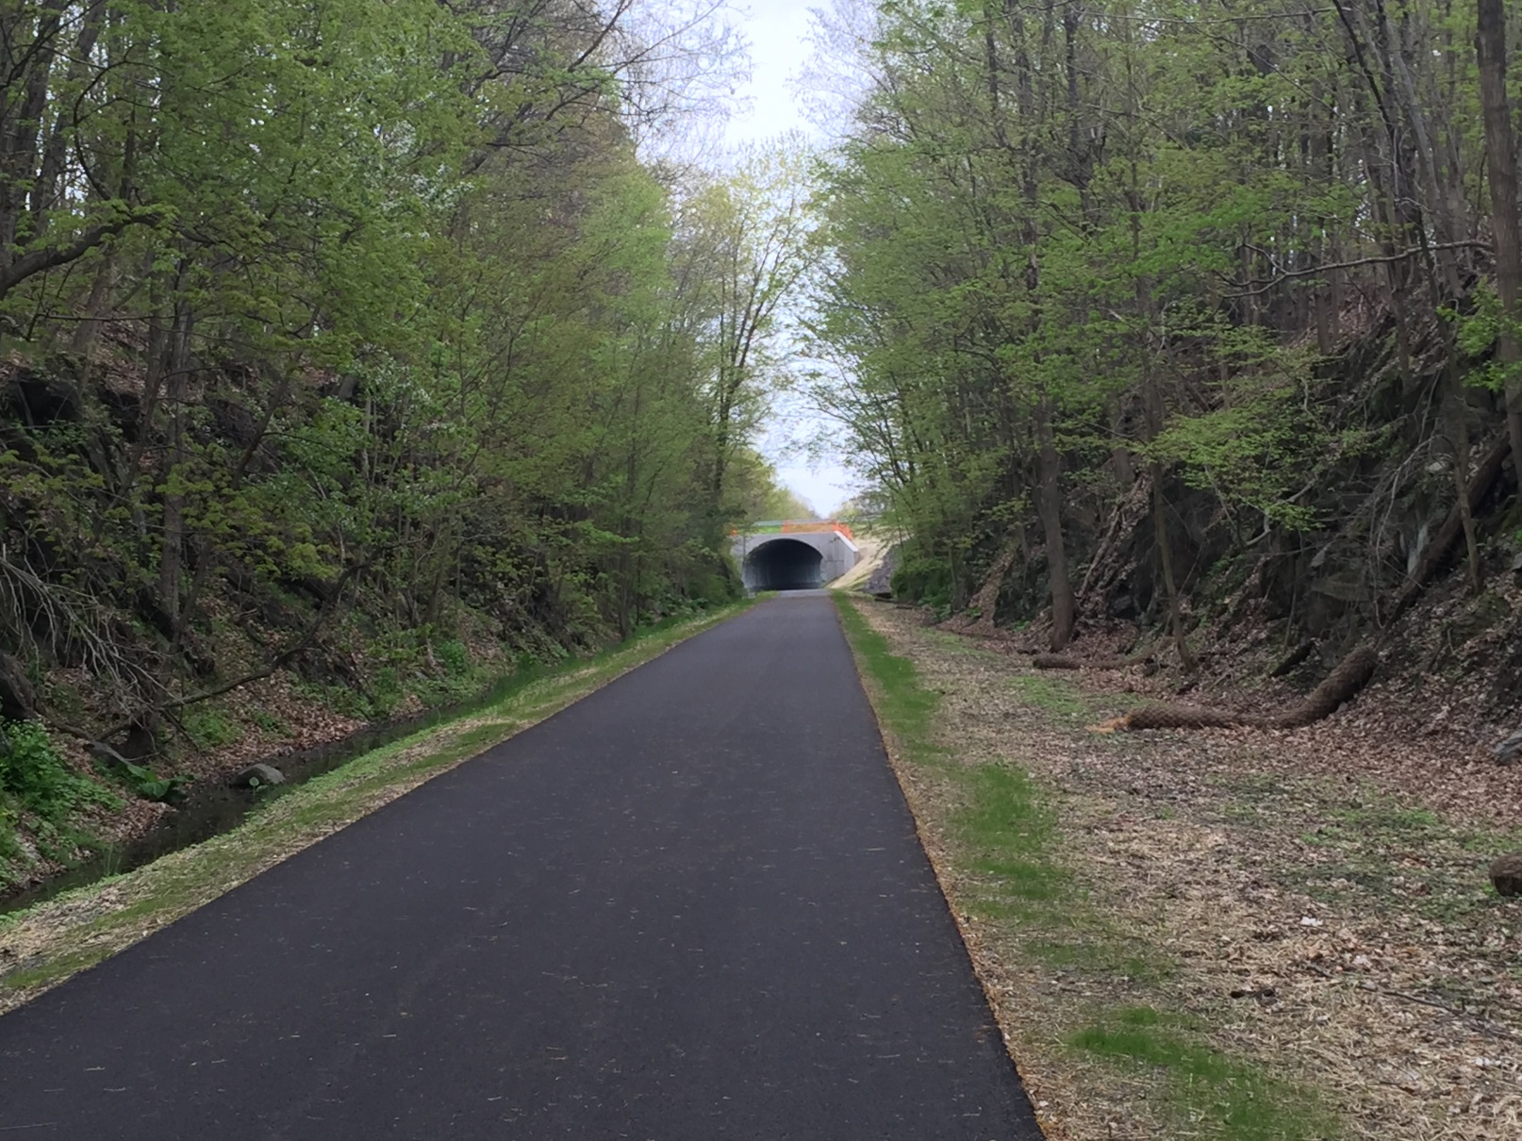
Hudson Valley Rail Trail
Phase 3: Tony Williams Park to New Paltz Road

Slide 9
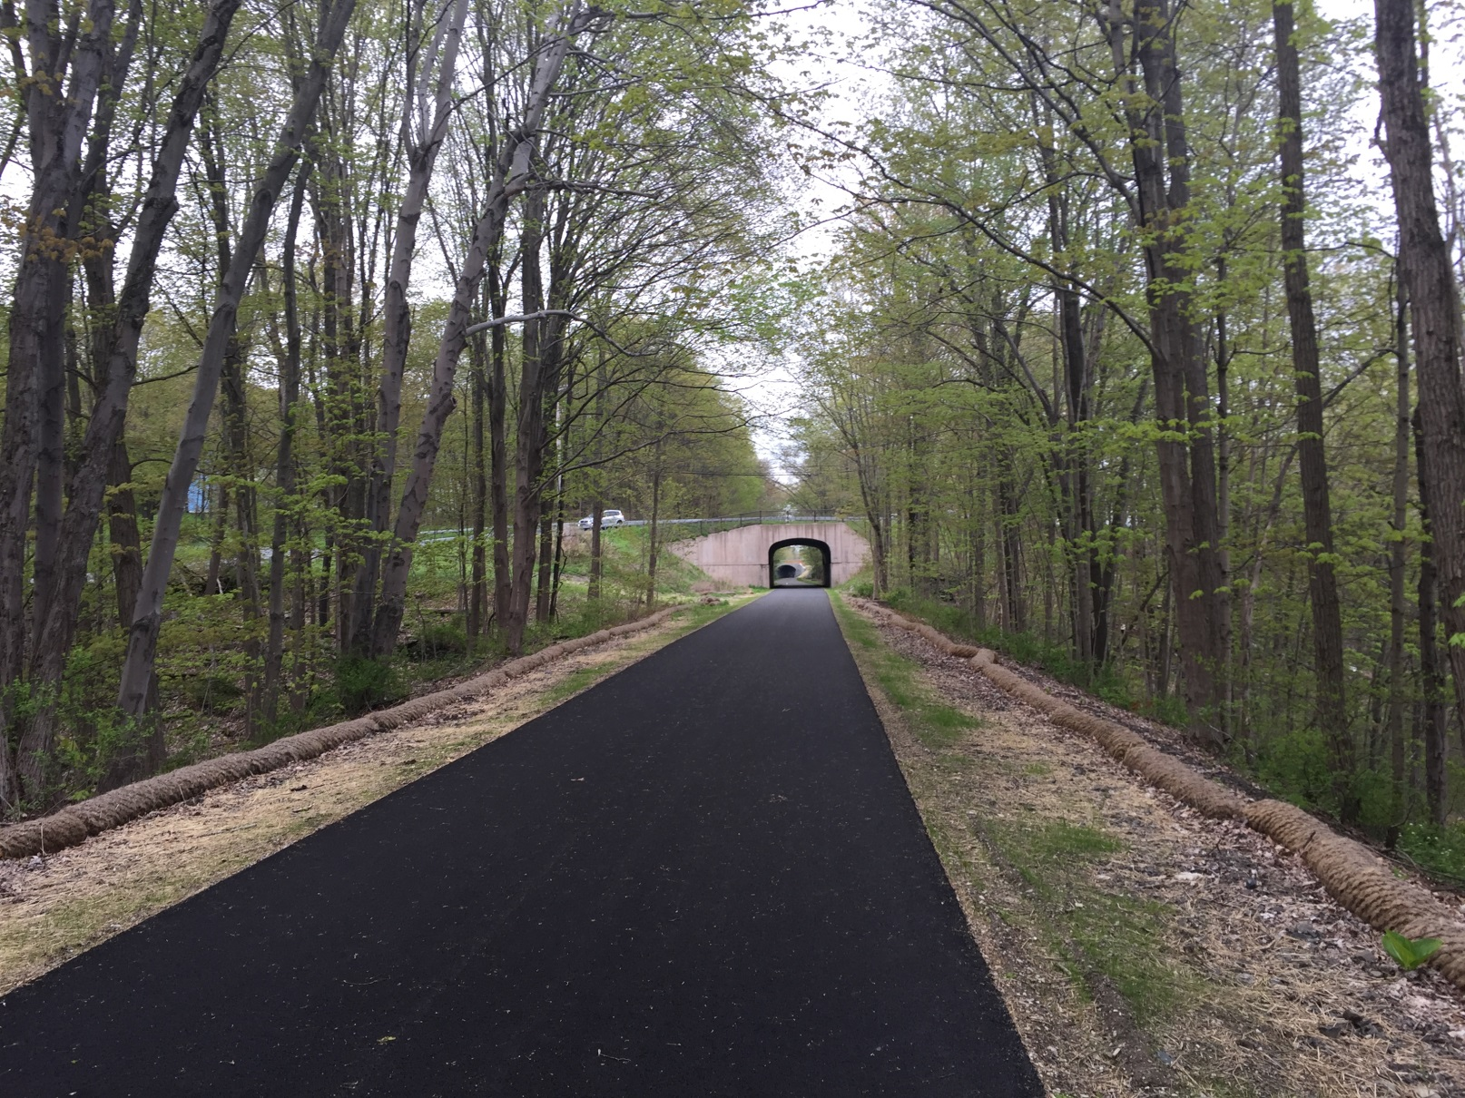
Hudson Valley Rail Trail
Phase 3: Tony Williams Park to New Paltz Road

Slide 10
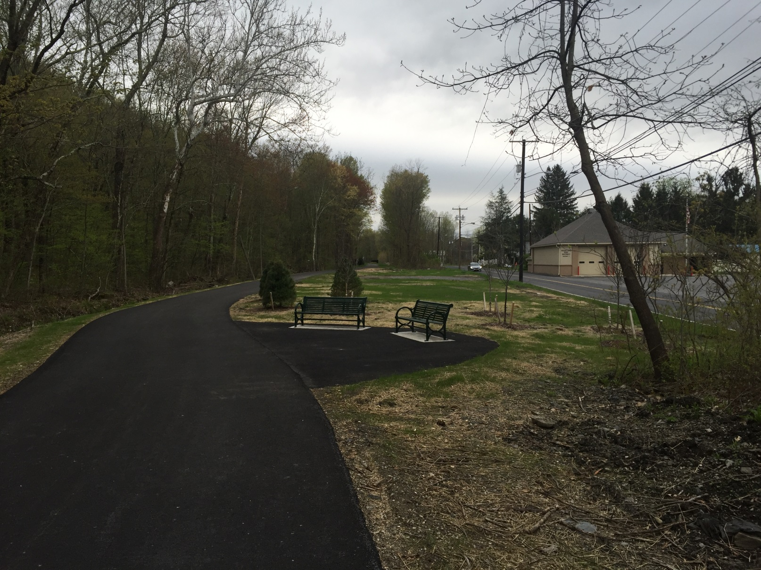
Hudson Valley Rail Trail
Phase 3: Tony Williams Park to New Paltz Road

Slide 11
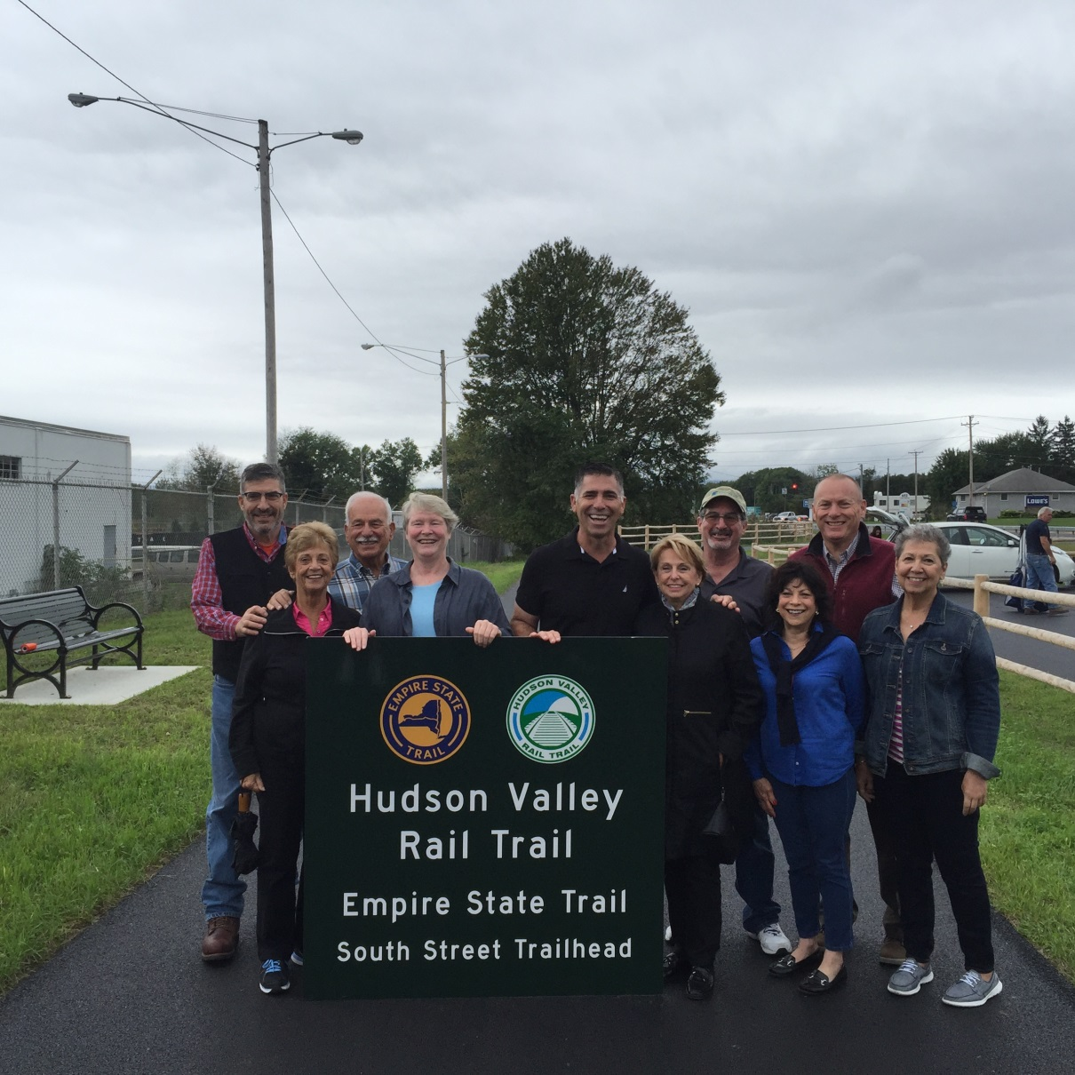
Hudson Valley Rail Trail
Phase 4 Opening: September 21, 2018

Slide 12
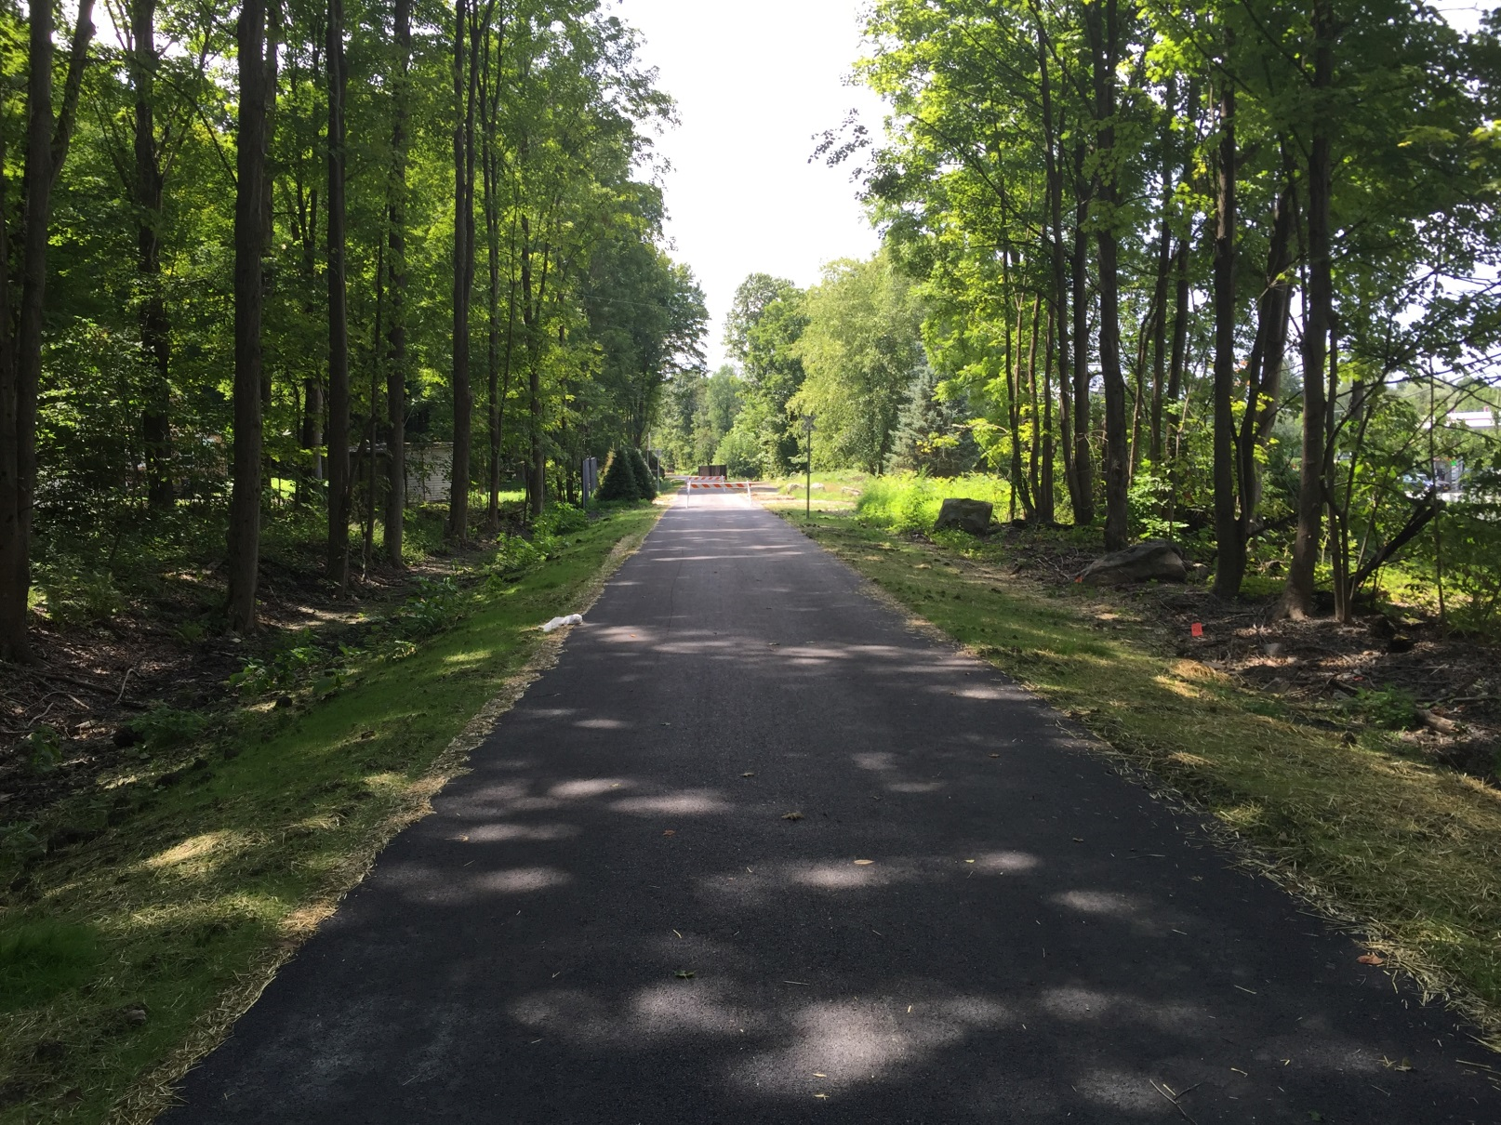
Hudson Valley Rail Trail
Phase 4 Project- New Paltz Road to South Street

Slide 13
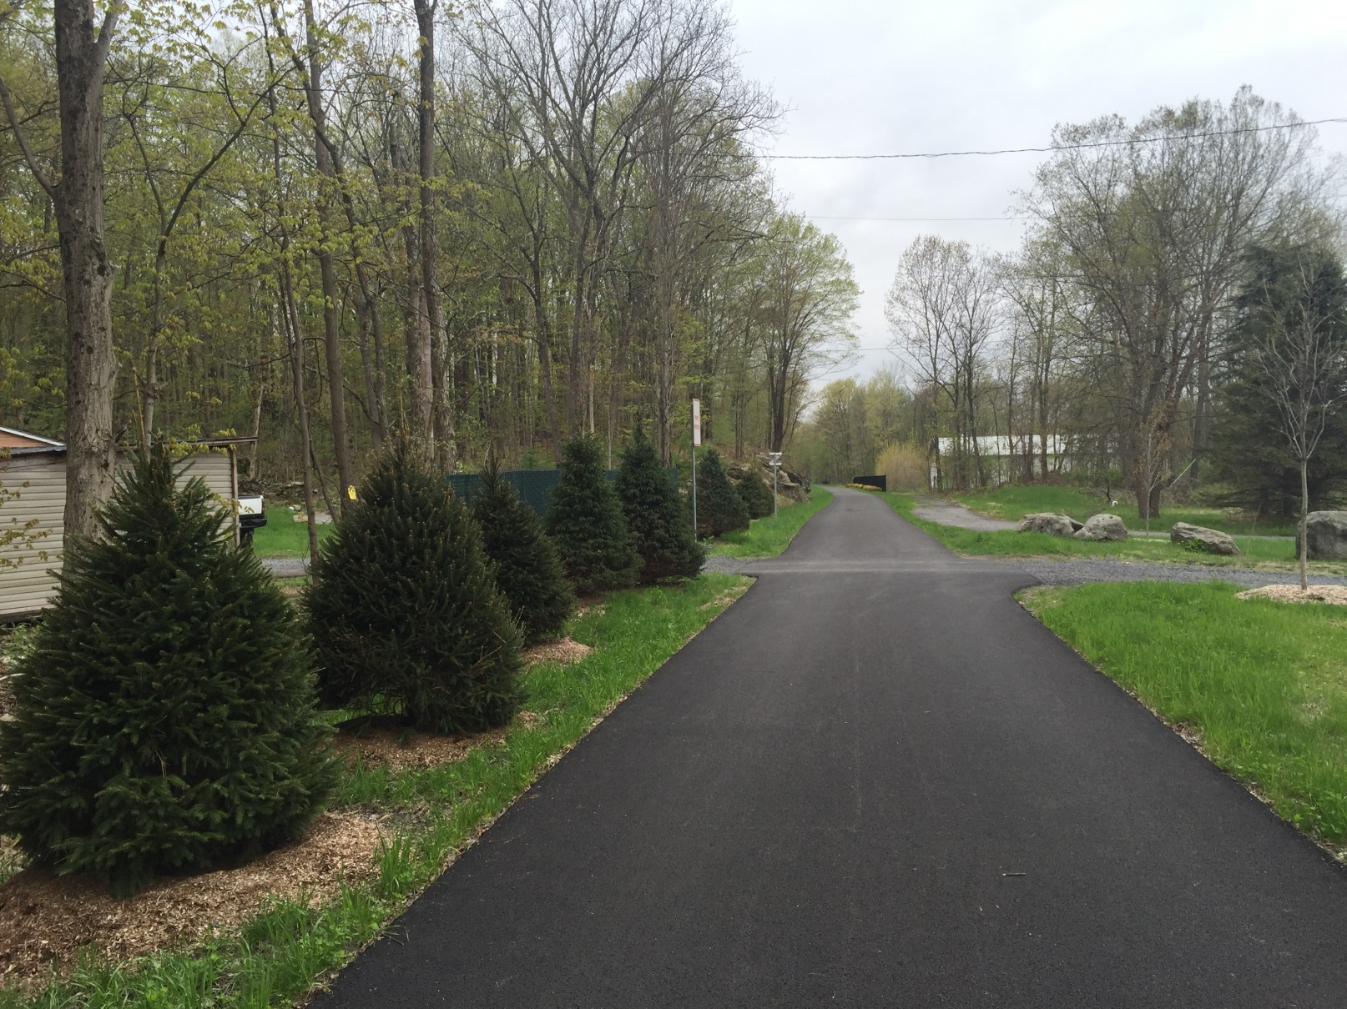
Hudson Valley Rail Trail
Phase 4 Project- New Paltz Road to South Street

Slide 14
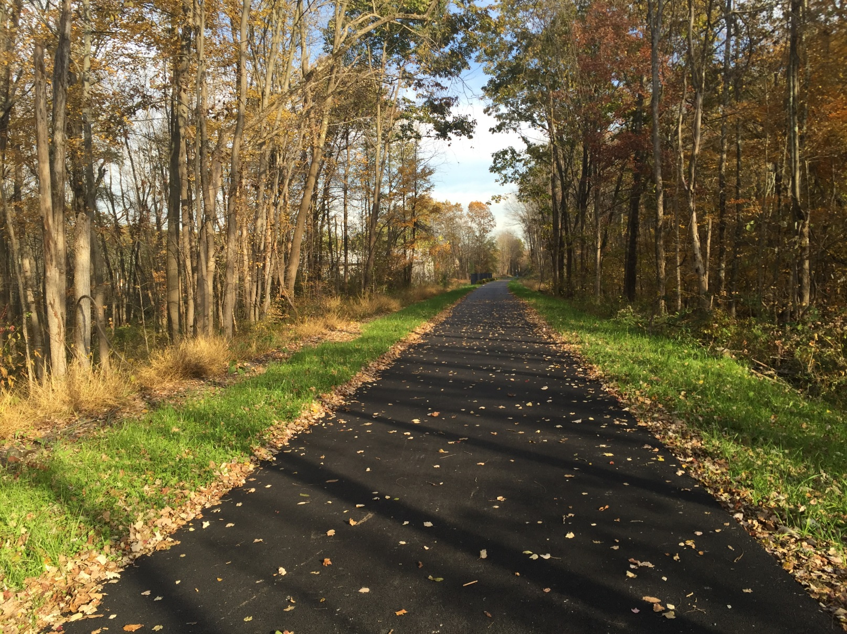
Hudson Valley Rail Trail
Phase 4 Project- New Paltz Road to South Street

Slide 15
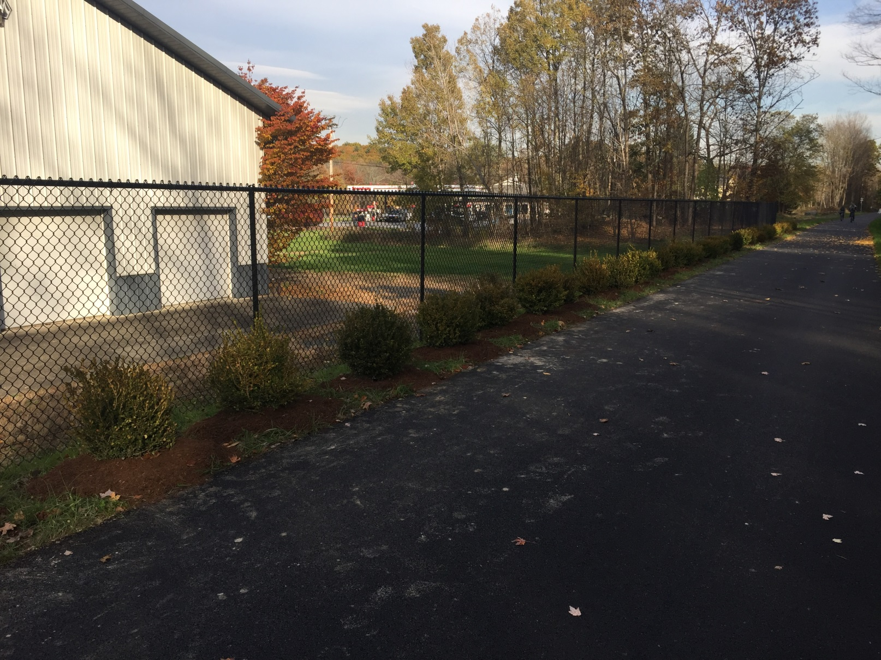
Hudson Valley Rail Trail
Phase 4 Project- New Paltz Road to South Street

Slide 16
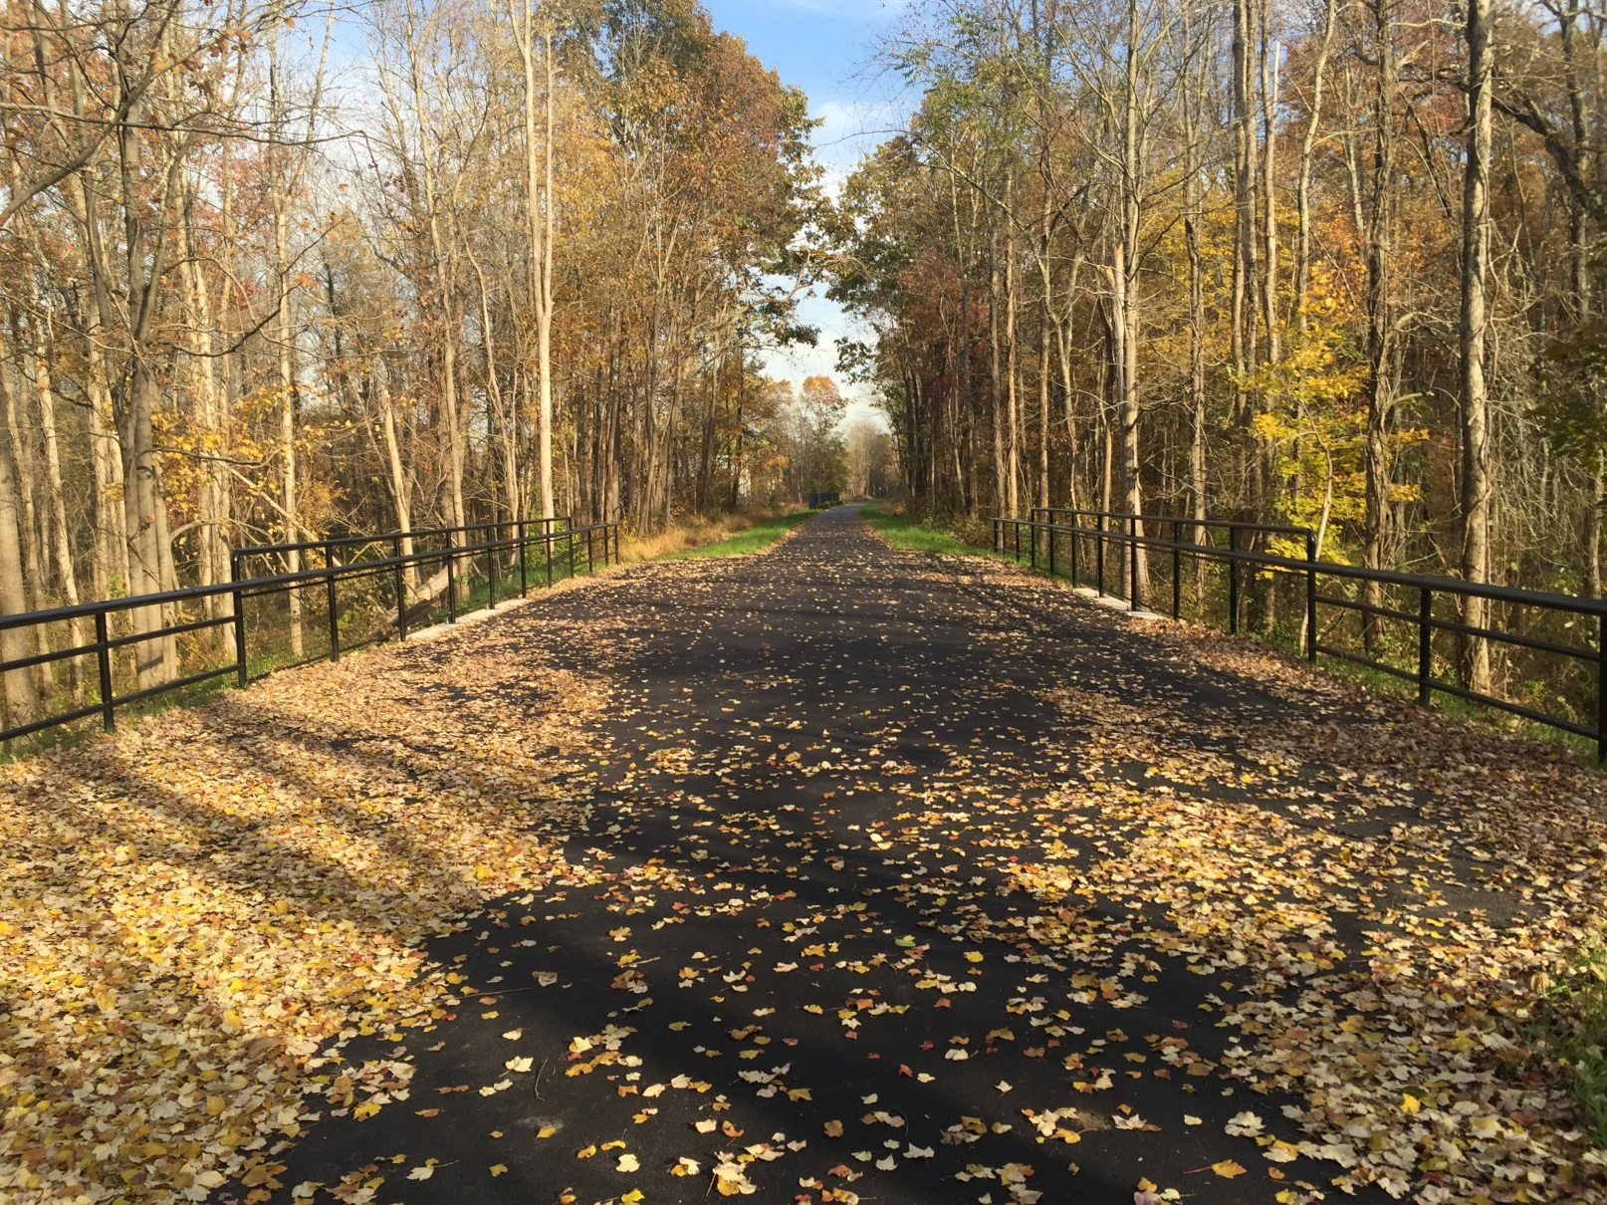
Hudson Valley Rail Trail
Phase 4 Project- New Paltz Road to South Street

Slide 17
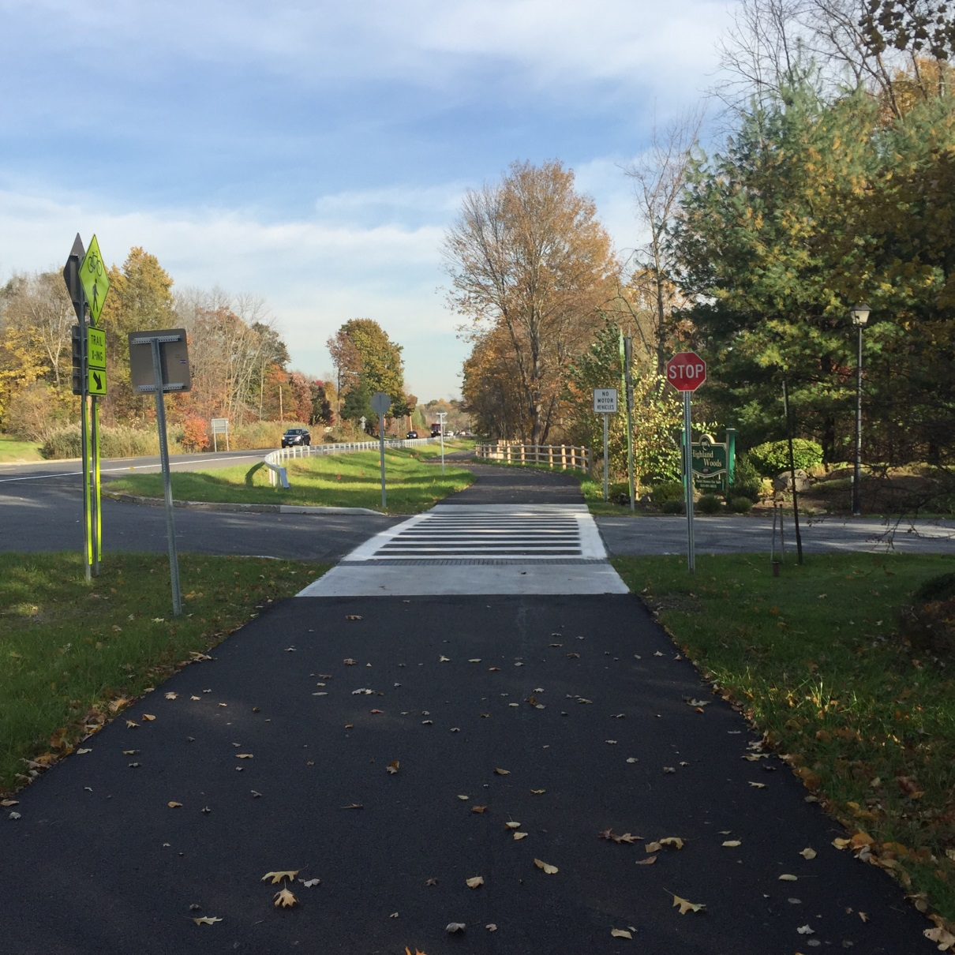
Hudson Valley Rail Trail
Phase 4 Project- New Paltz Road to South Street

Slide 18
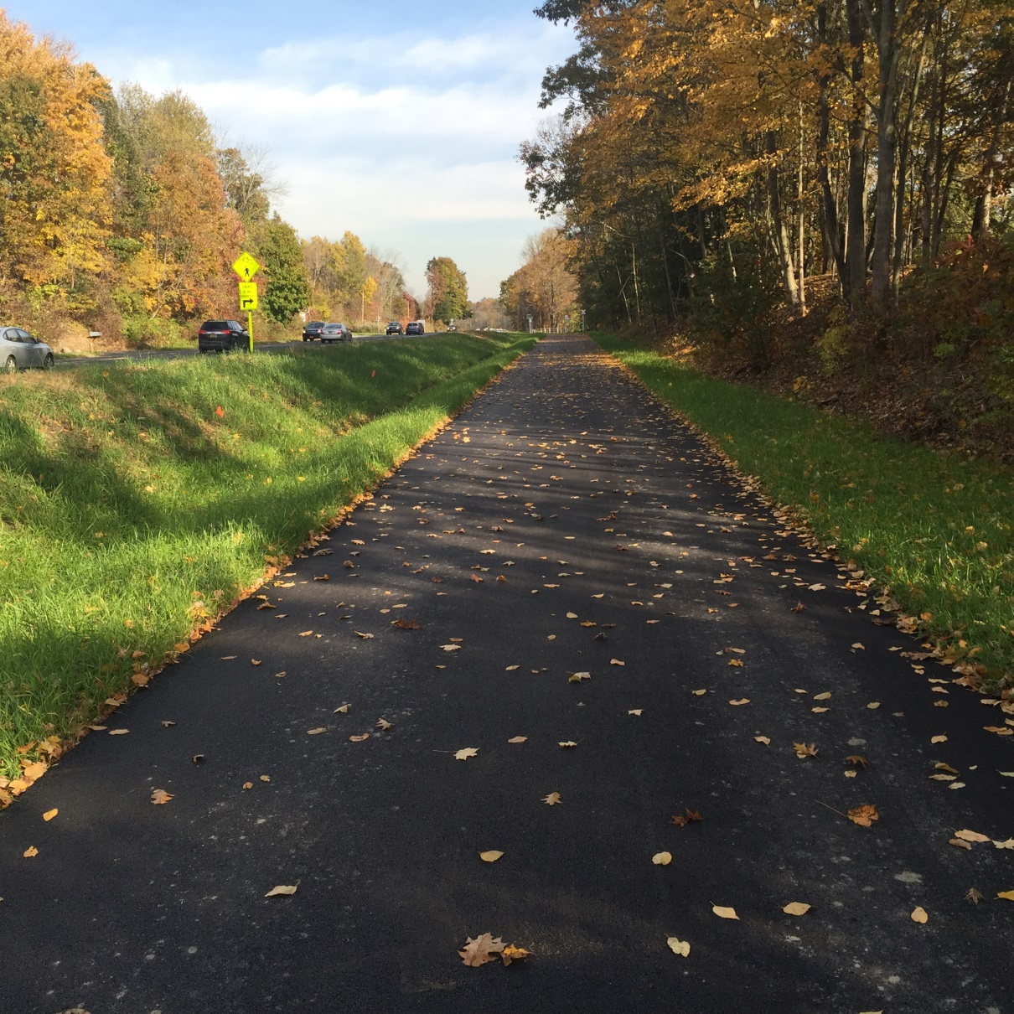
Hudson Valley Rail Trail
Phase 4 Project- New Paltz Road to South Street

Slide 19
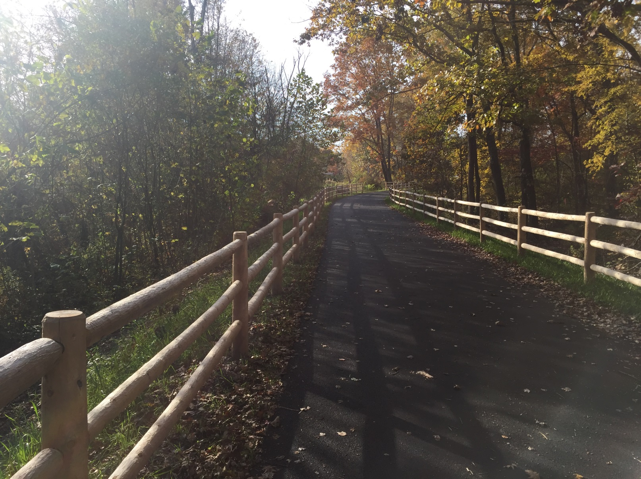
Hudson Valley Rail Trail
Phase 4 Project- New Paltz Road to South Street

Slide 20
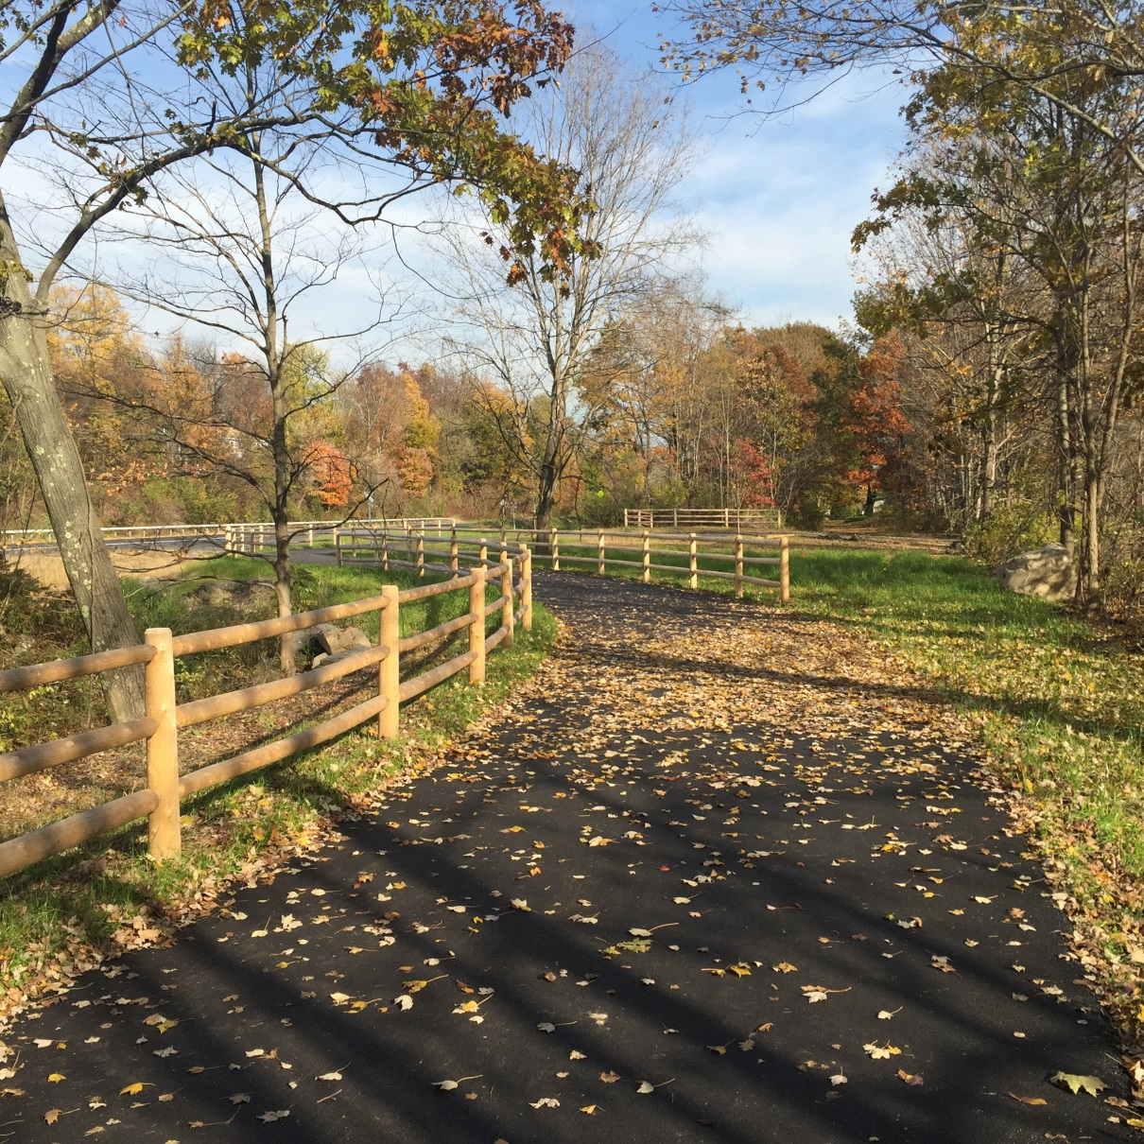
Hudson Valley Rail Trail
Phase 4 Project- New Paltz Road to South Street

Slide 21
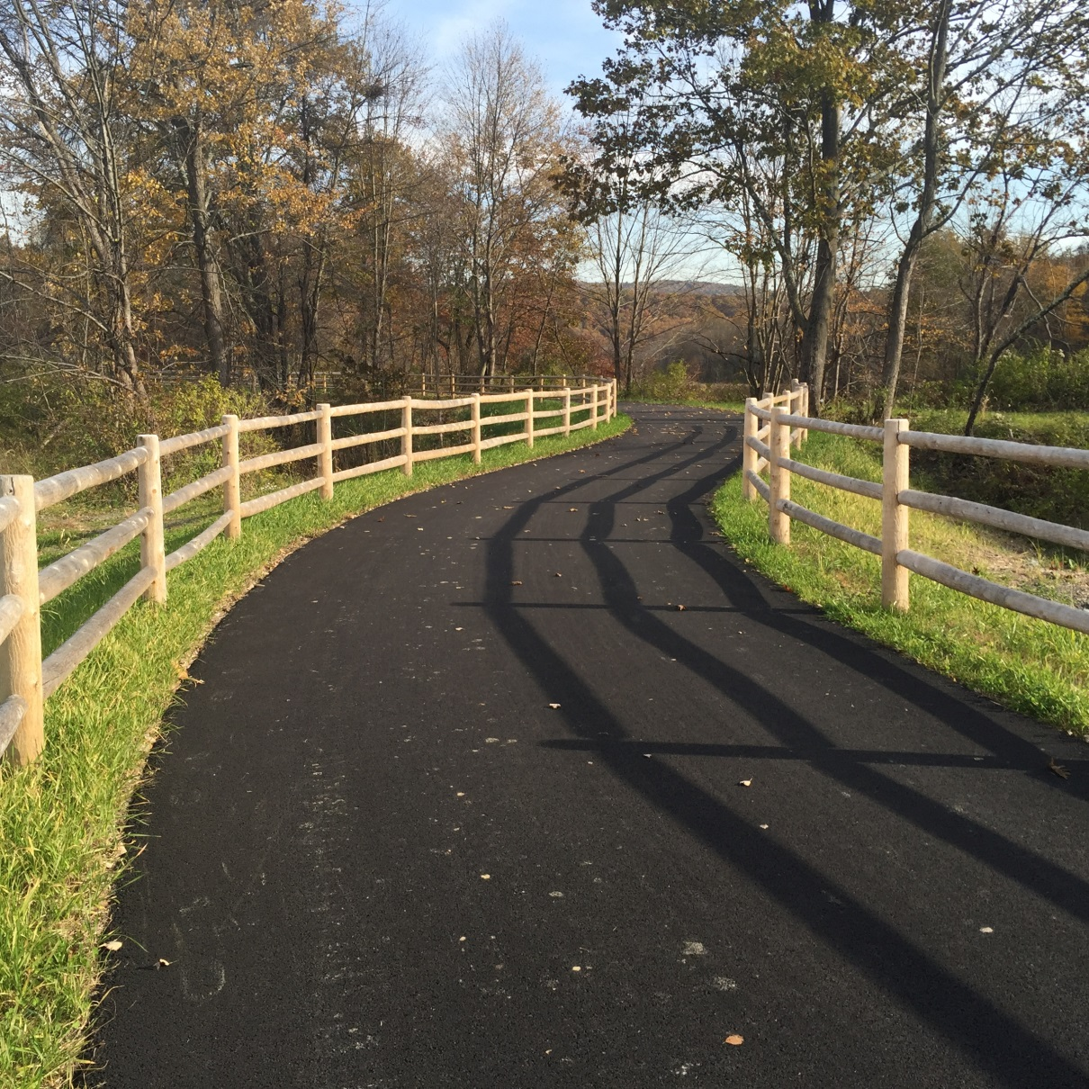
Hudson Valley Rail Trail
Phase 4 Project- New Paltz Road to South Street

Slide 22
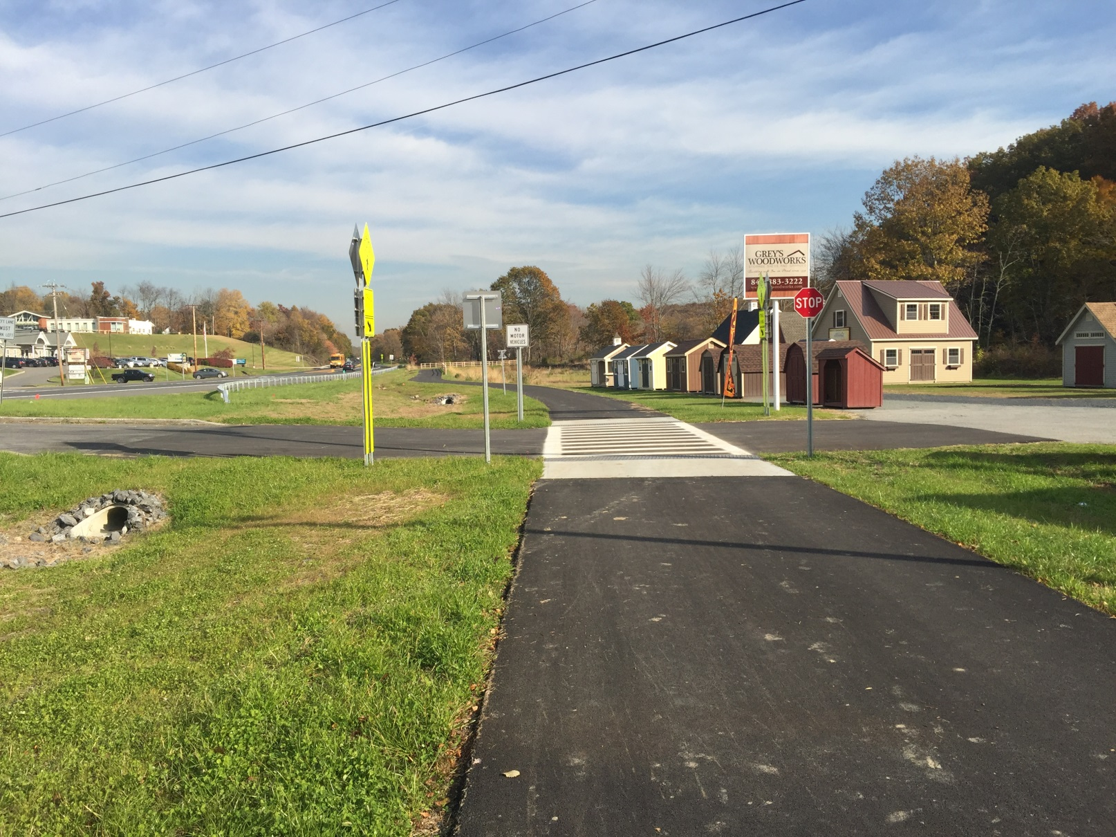
Hudson Valley Rail Trail
Phase 4 Project- New Paltz Road to South Street

Slide 23
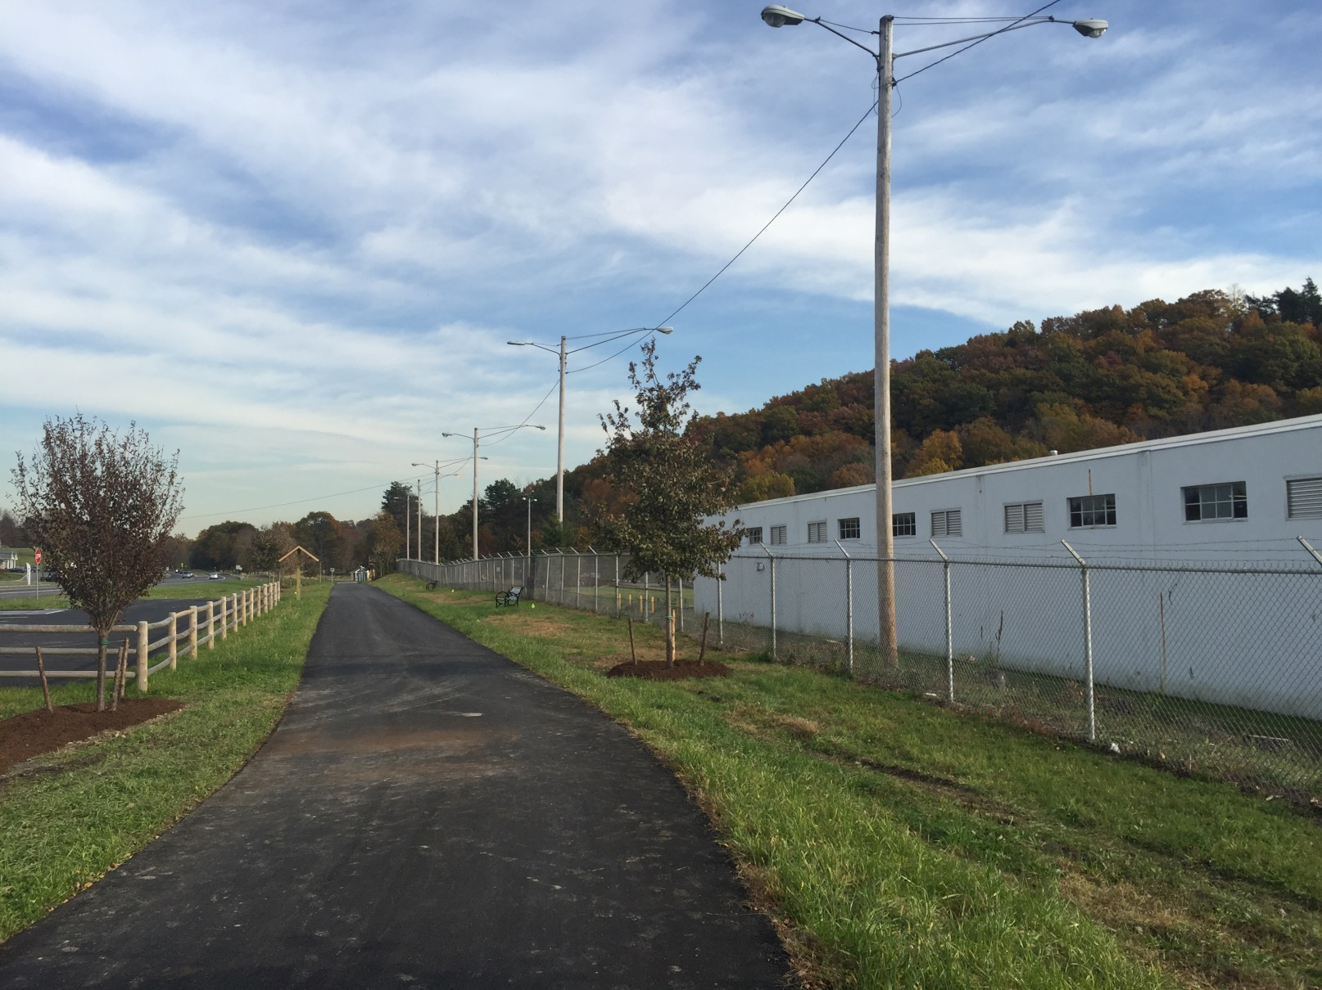
Hudson Valley Rail Trail
Phase 4 Project- New Paltz Road to South Street

Slide 24
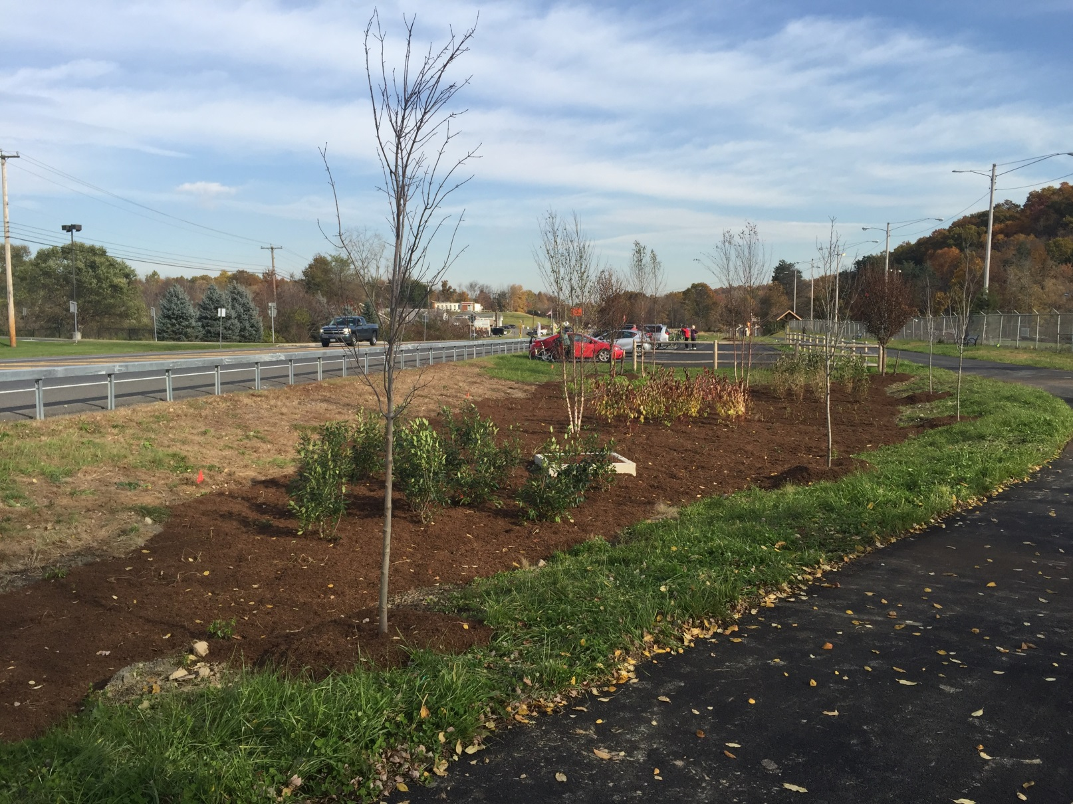
Hudson Valley Rail Trail
Phase 4 Project- New Paltz Road to South Street

Slide 25
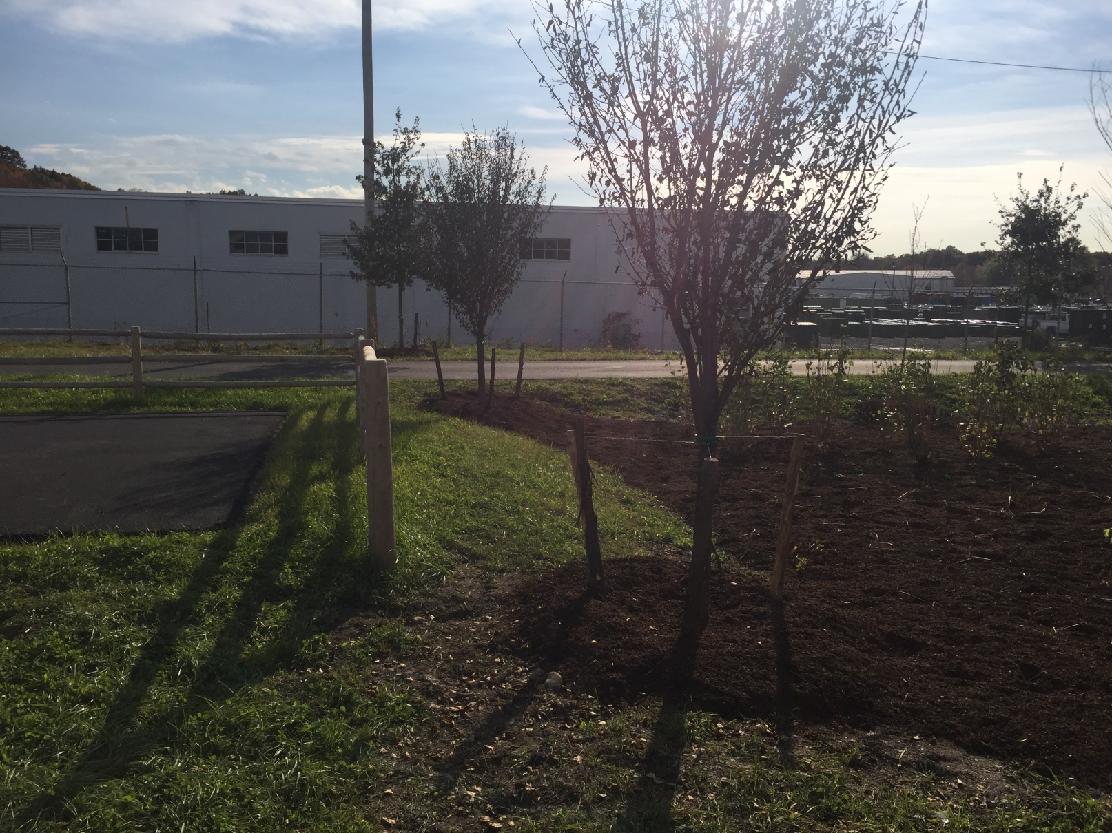
Hudson Valley Rail Trail
Phase 4 Project- New Paltz Road to South Street

Slide 26
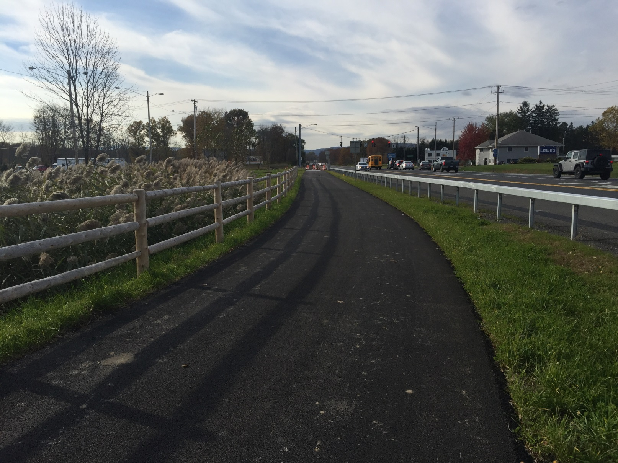
Hudson Valley Rail Trail
Phase 4 Project- New Paltz Road to South Street

Slide 27
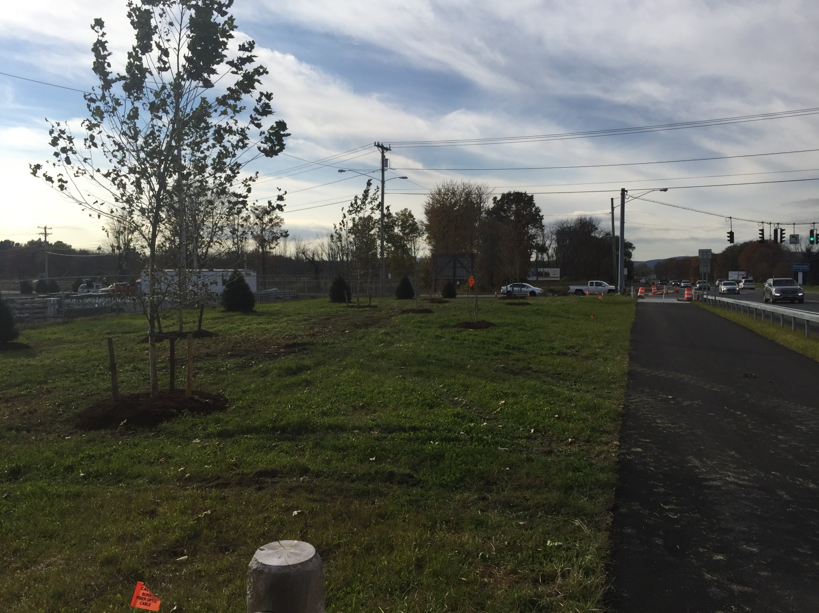
Hudson Valley Rail Trail
Phase 4 Project- New Paltz Road to South Street

Slide 28
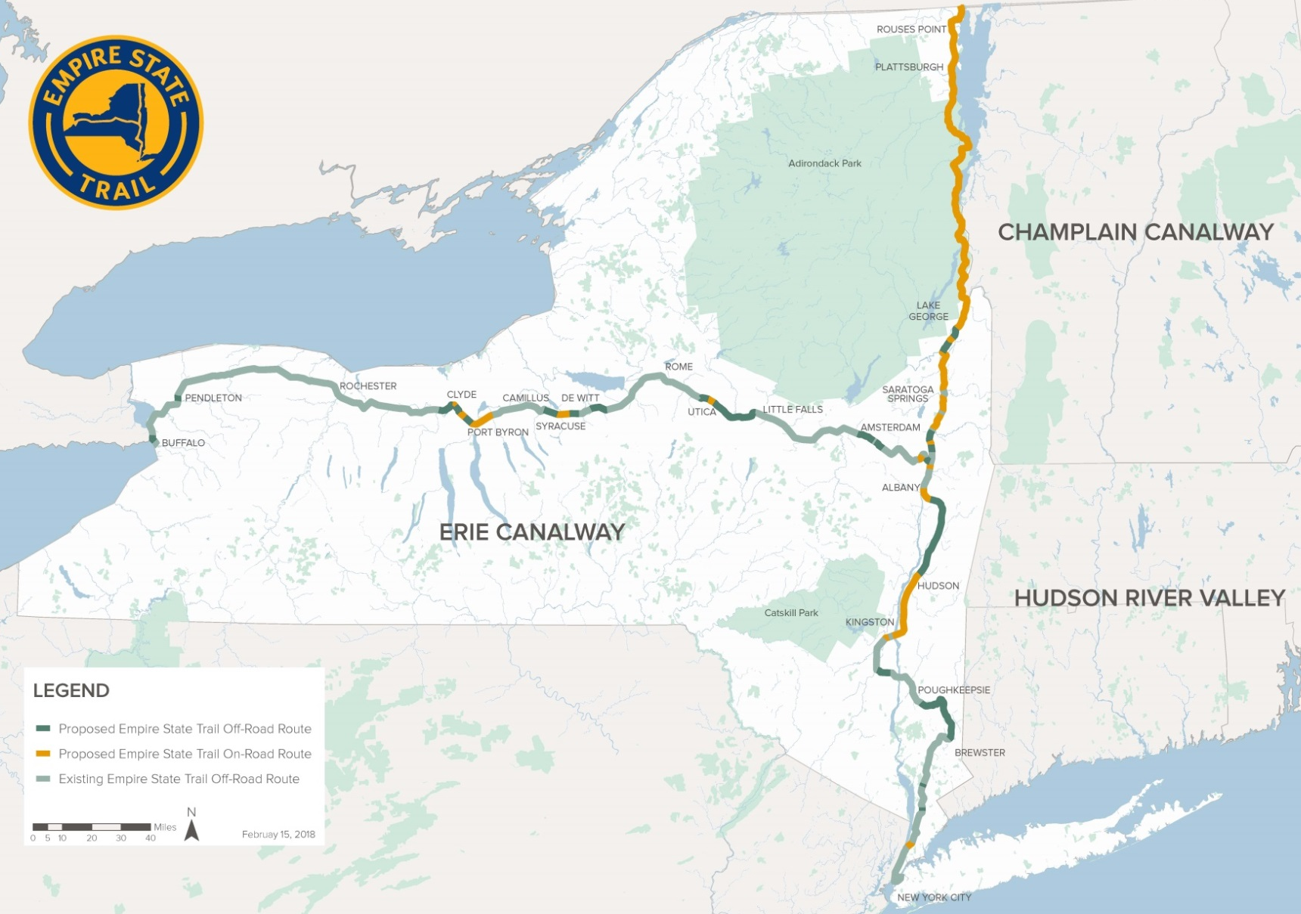
Future Empire State Trail 2020
Longest Multi-Use State Trail in Nation (750 Miles)

Slide 29

Future Empire State Trail 2020
Crosses Walkway Over the Hudson Into Ulster County

Slide 30
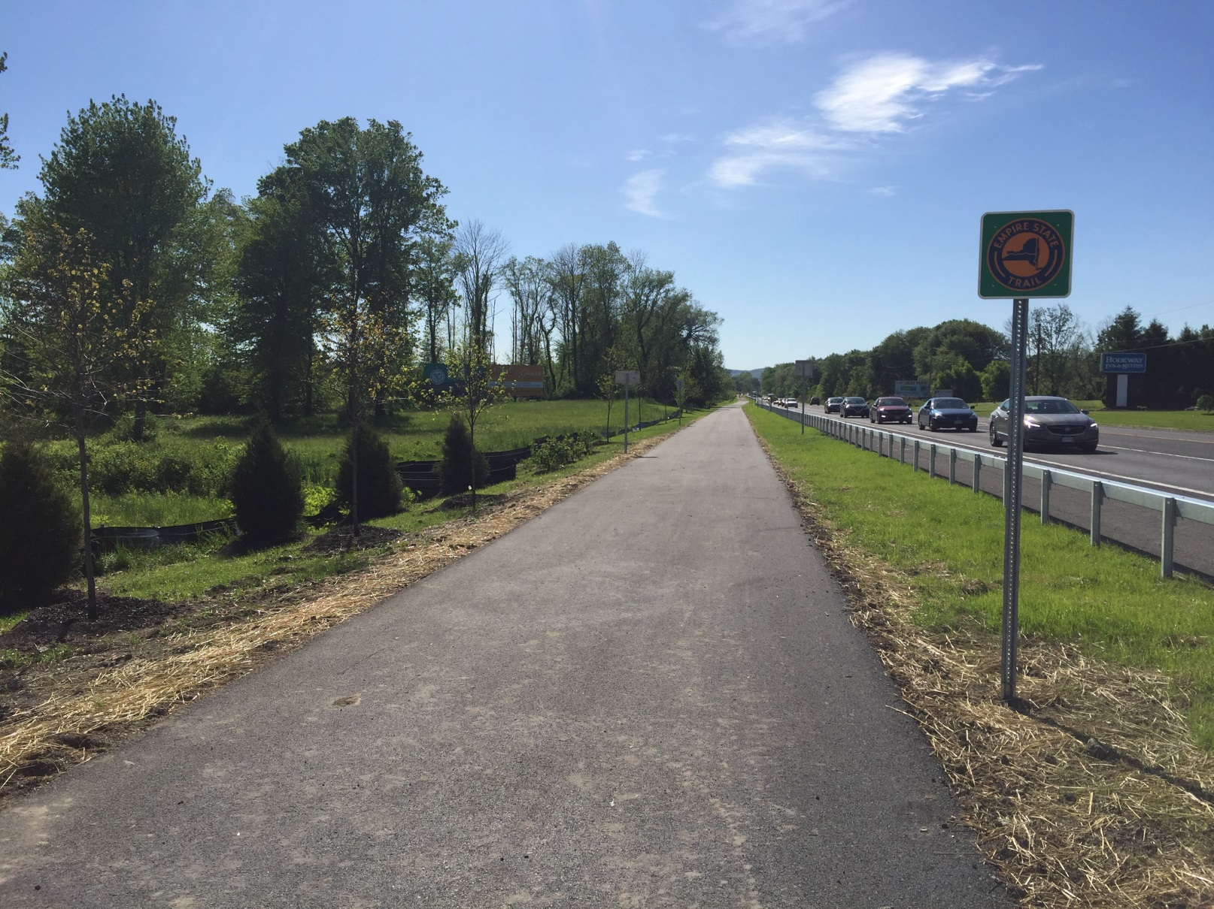
HVRT / Empire State Trail
South Street to Wallkill Valley Rail Trail

Slide 31
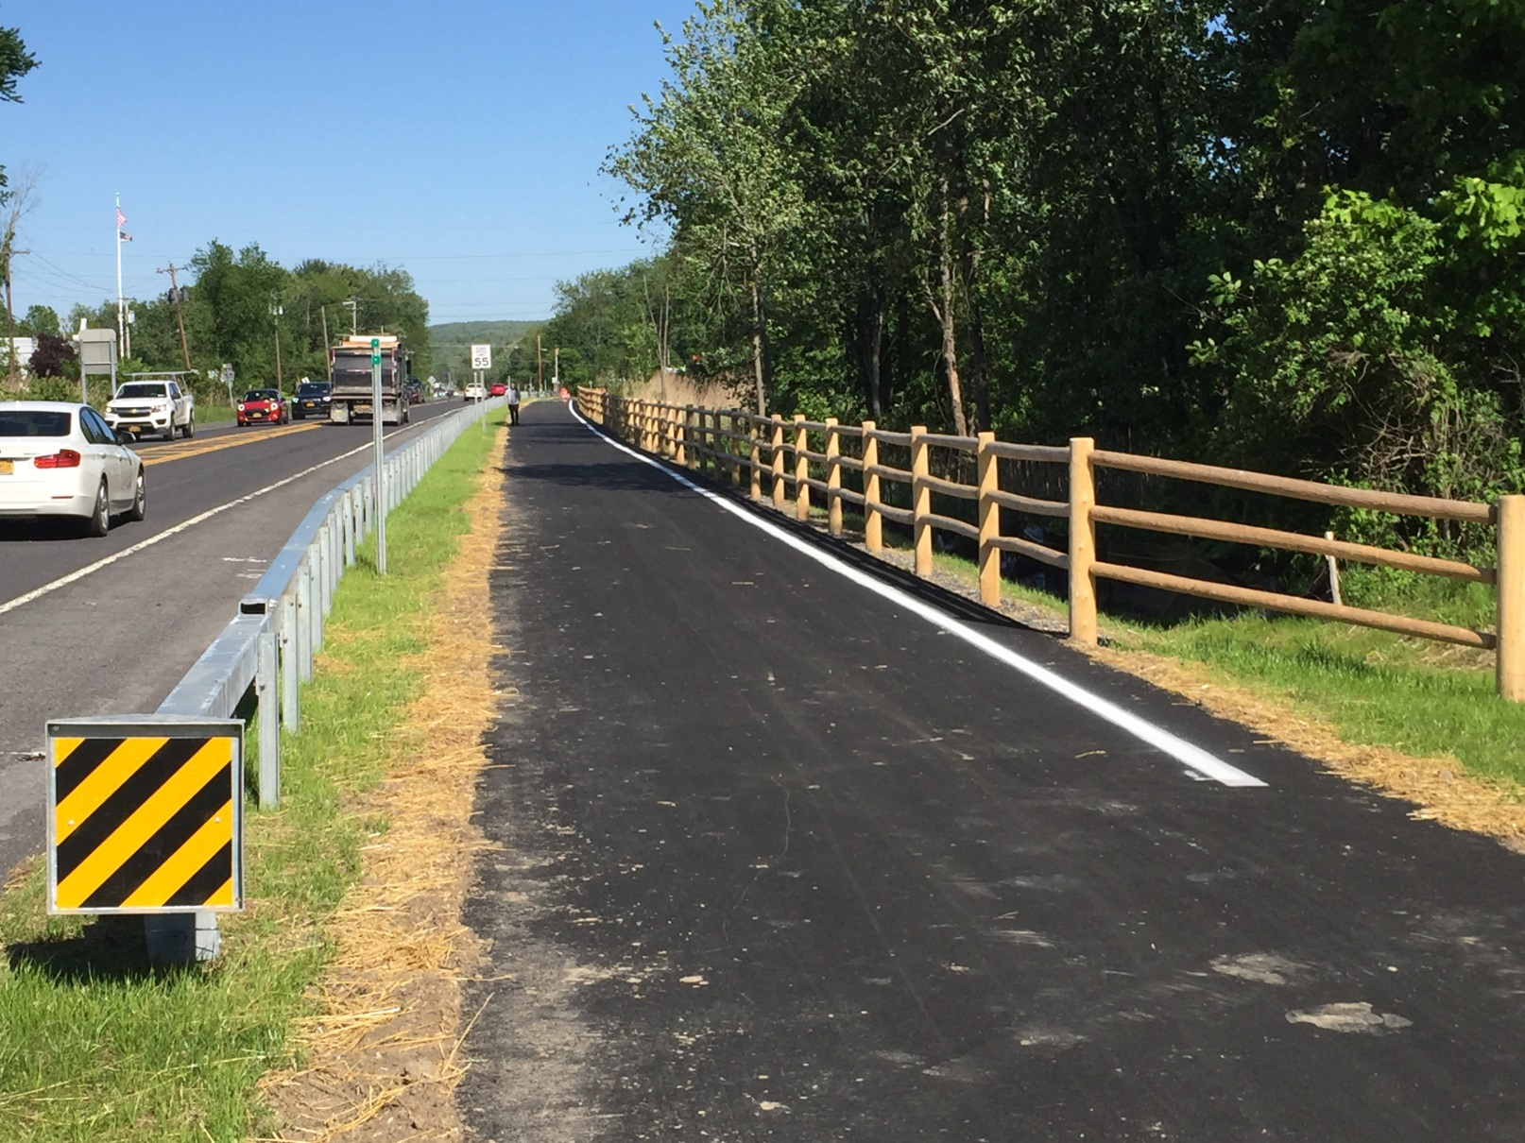
HVRT / Empire State Trail
South Street to Wallkill Valley Rail Trail

Slide 32
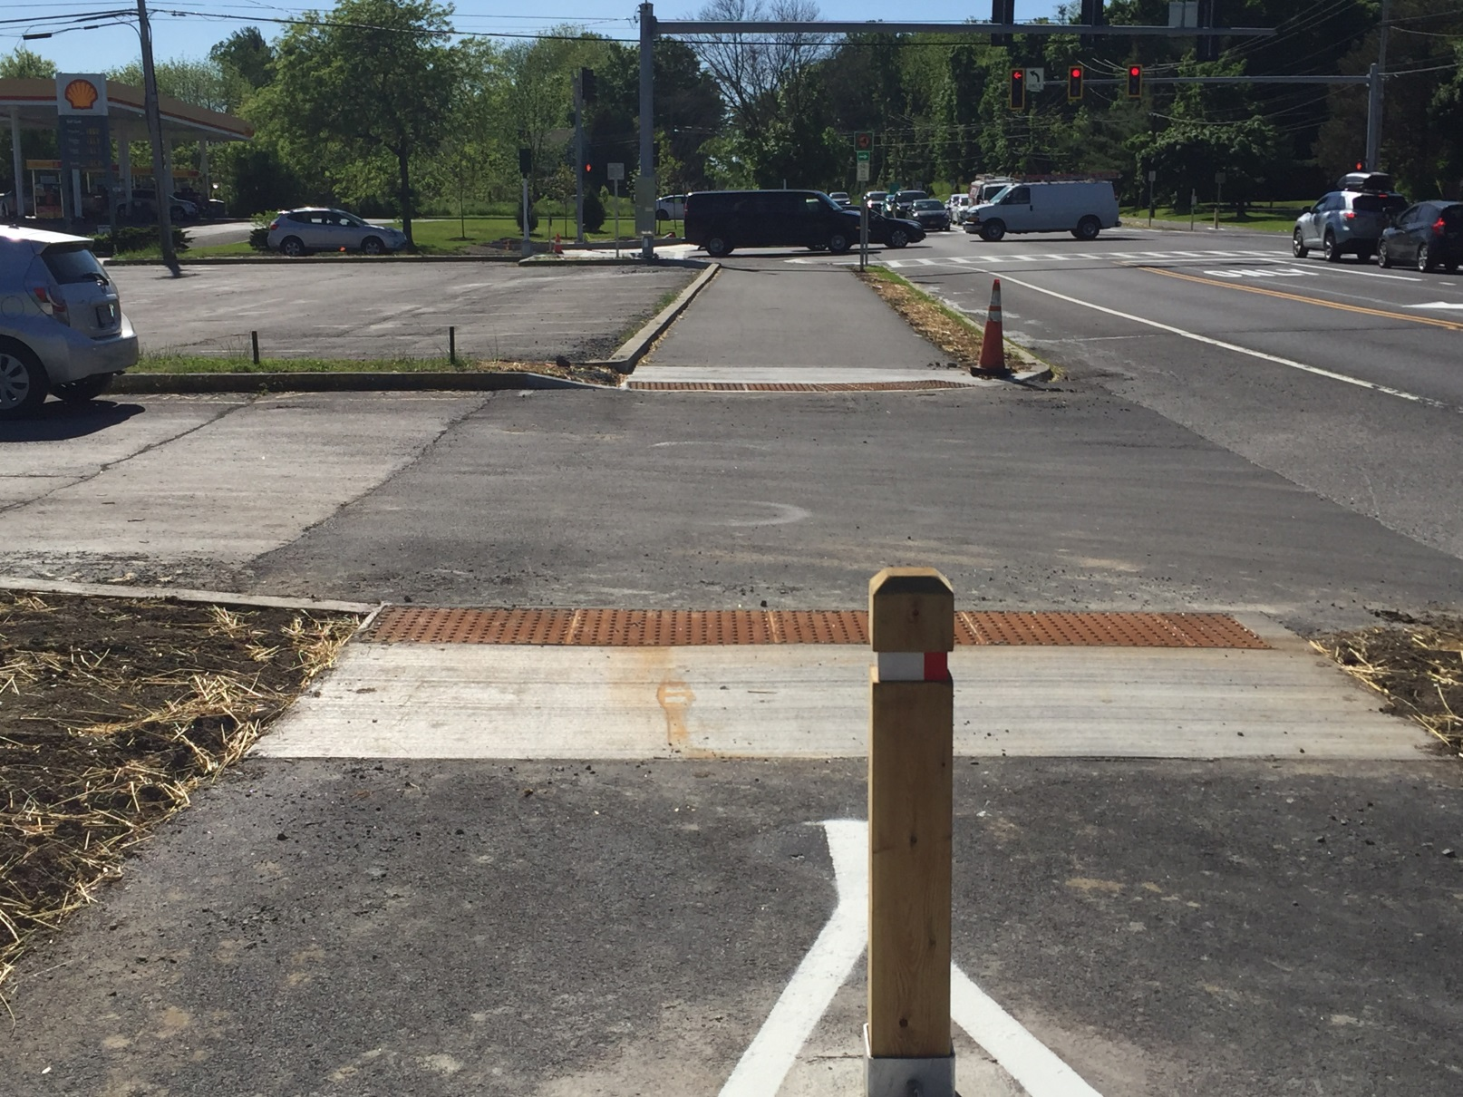
HVRT / Empire State Trail
South Street to Wallkill Valley Rail Trail

Slide 33
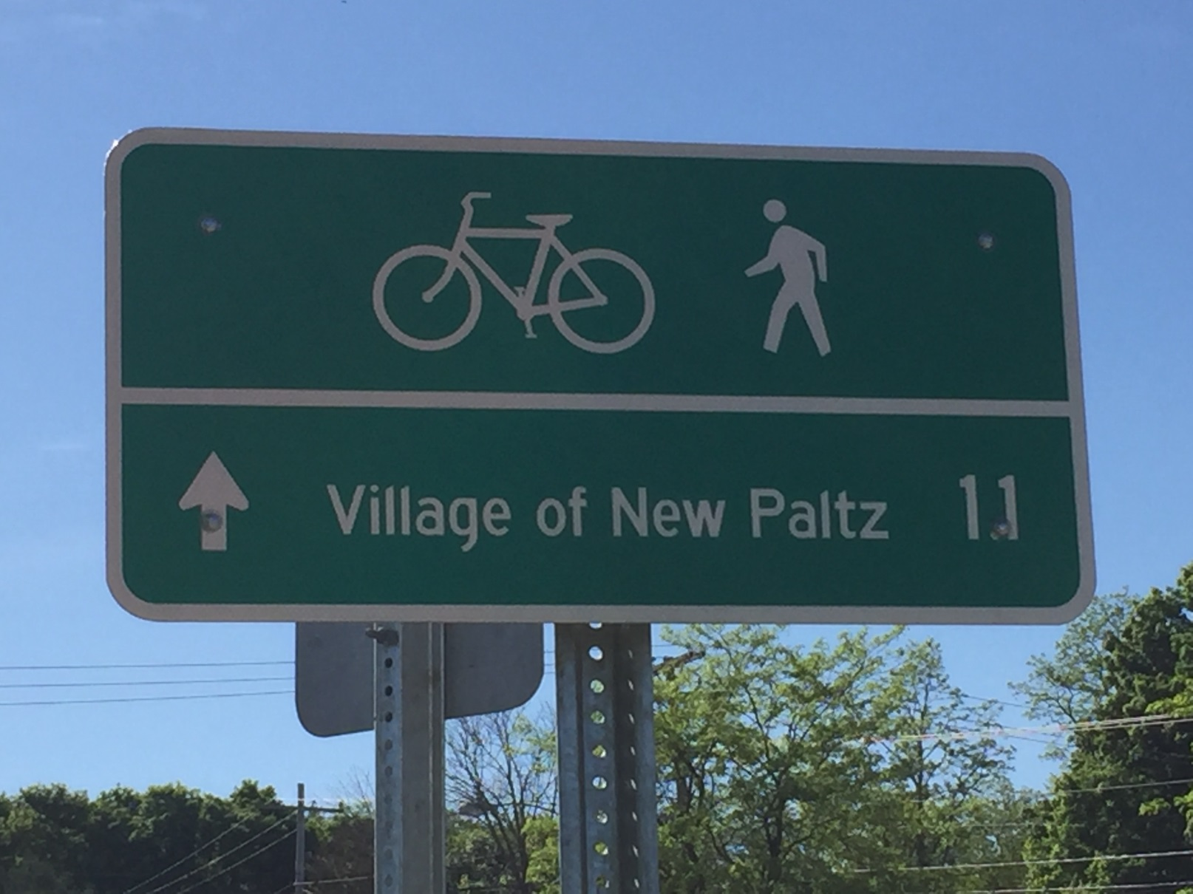
HVRT / Empire State Trail
South Street to Wallkill Valley Rail Trail

Slide 34
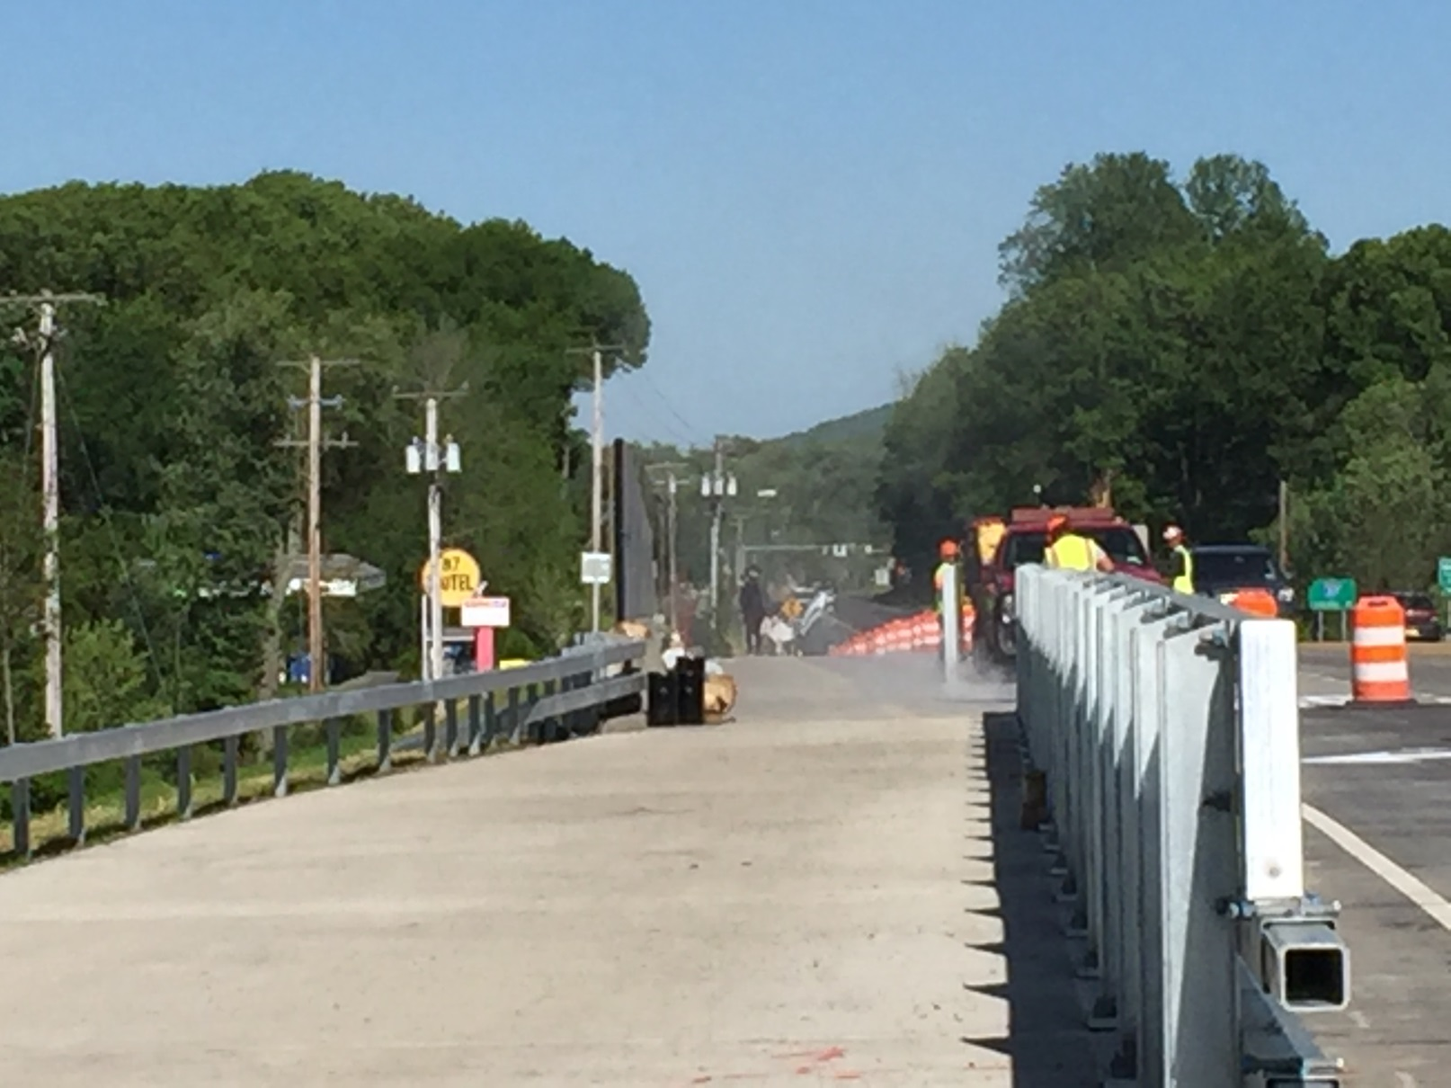
HVRT / Empire State Trail
South Street to Wallkill Valley Rail Trail

Slide 35
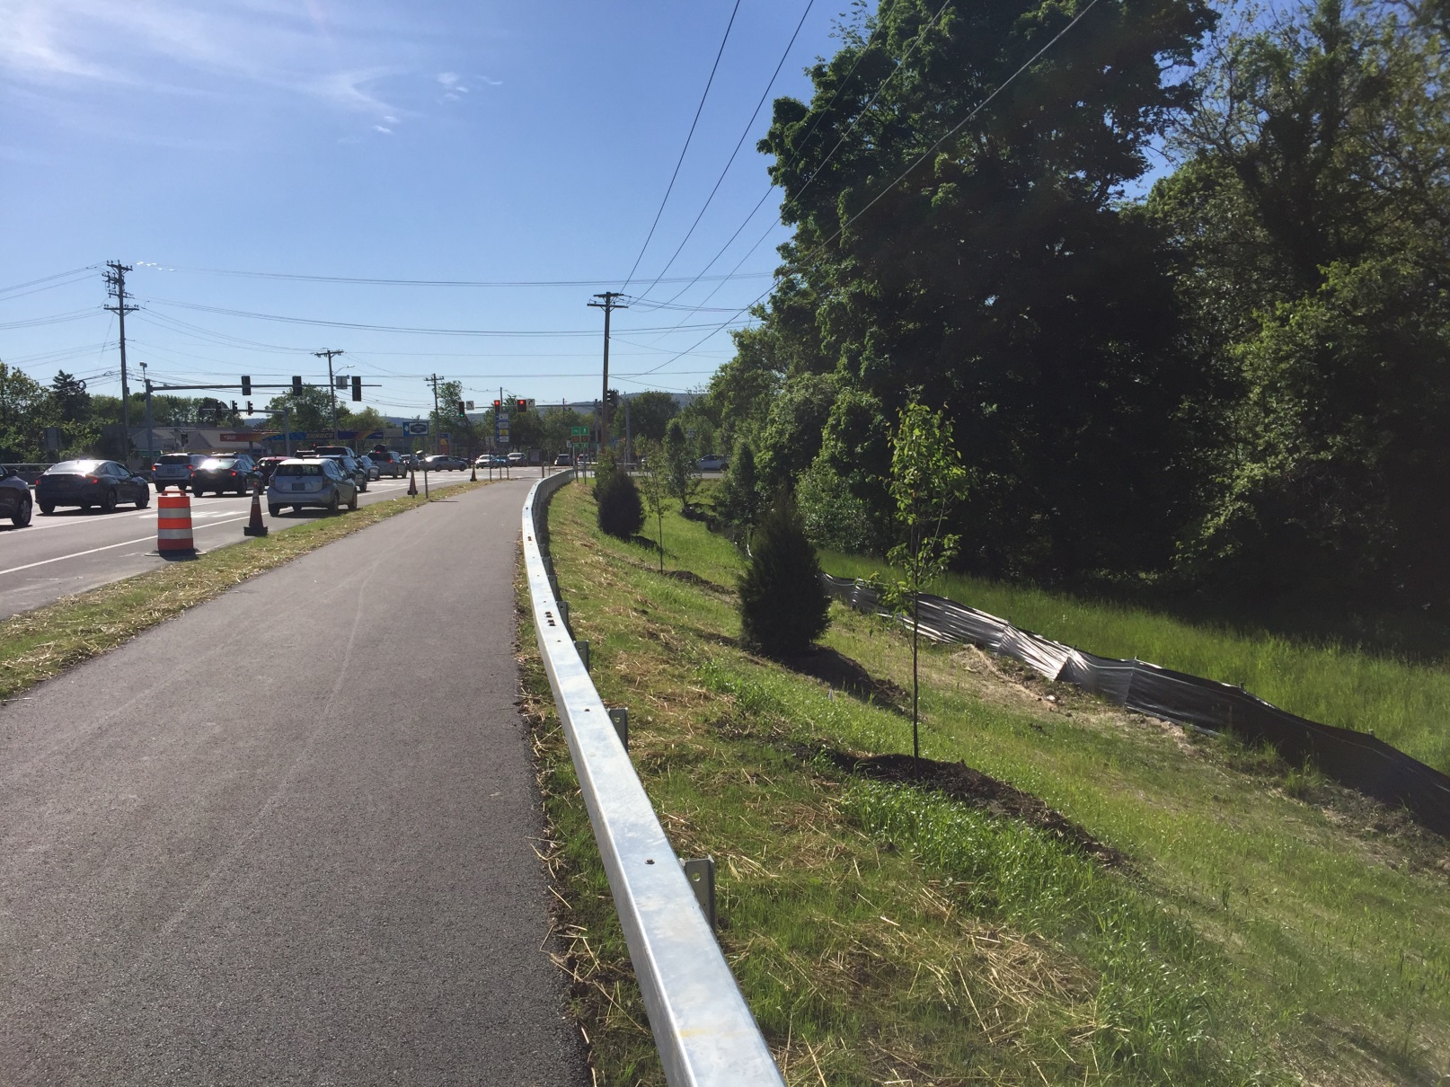
HVRT / Empire State Trail
South Street to Wallkill Valley Rail Trail

Slide 36
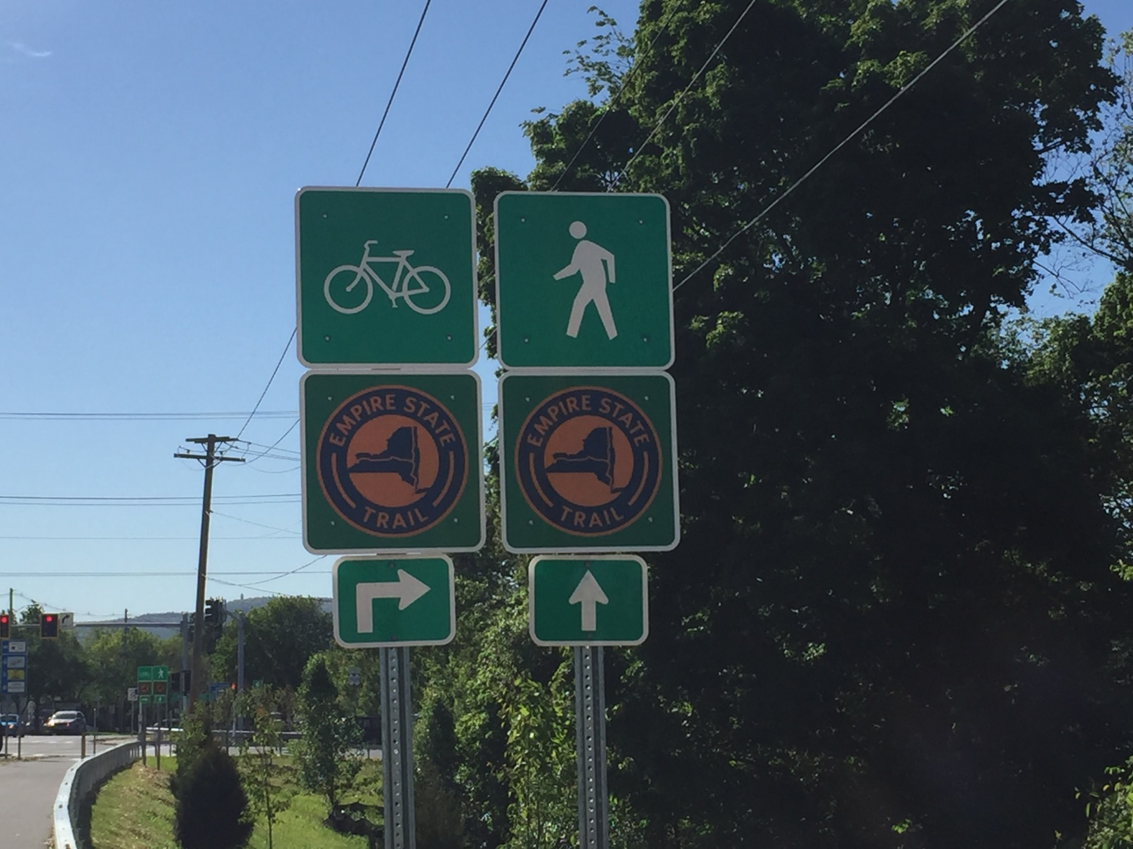
HVRT / Empire State Trail
South Street to Wallkill Valley Rail Trail

Slide 37
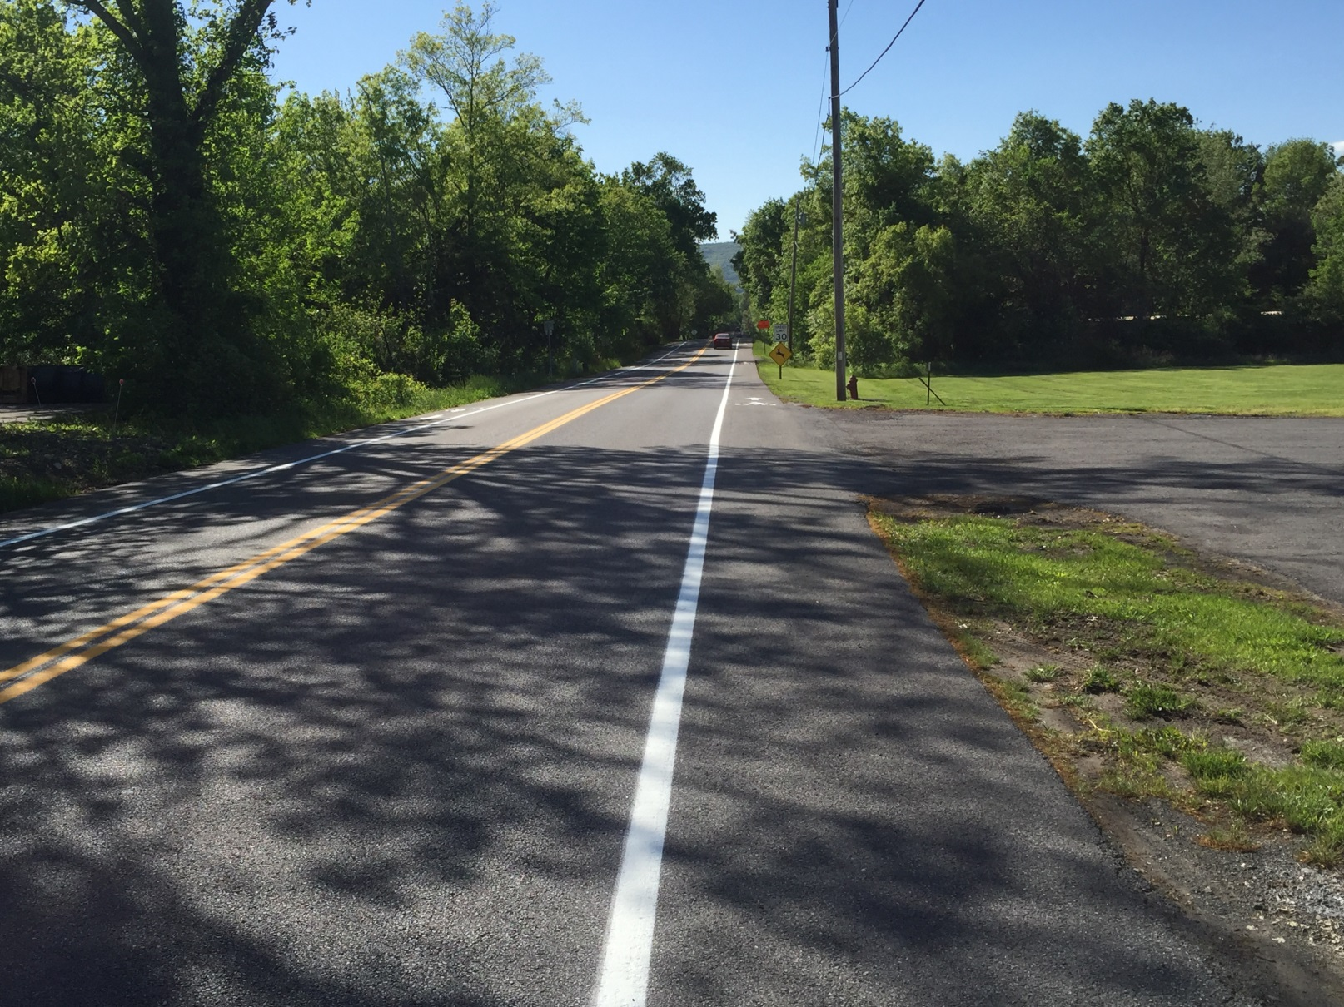
HVRT / Empire State Trail
South Street to Wallkill Valley Rail Trail

Slide 38
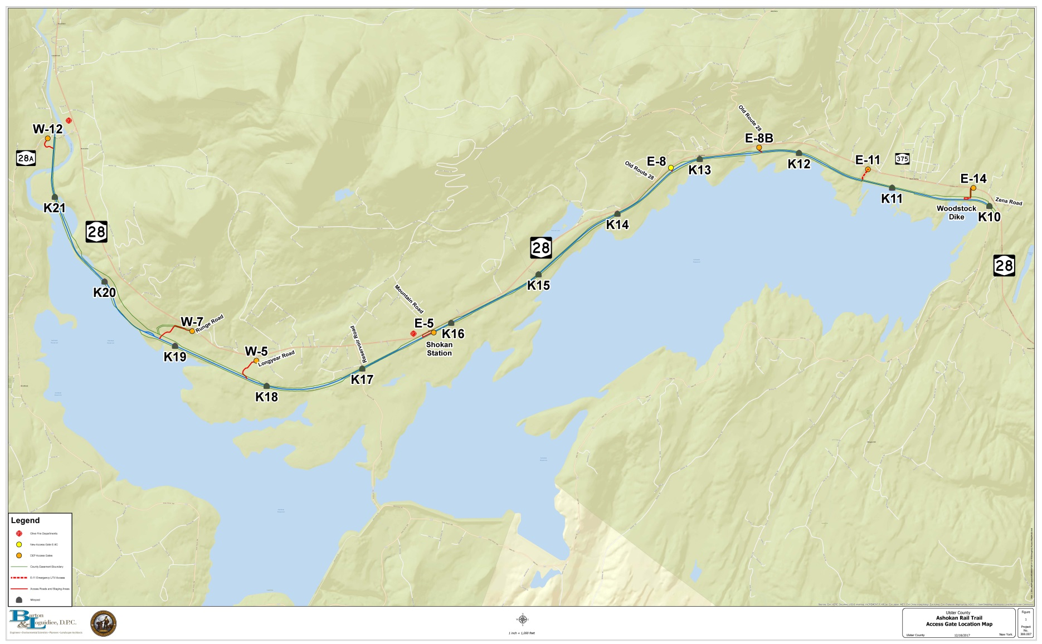
Ashokan Rail Trail
Basin Road in West Hurley to Route 28A in Boiceville
Boiceville
West Hurley
Ashokan Reservoir
Shokan
Ashokan Reservoir
Ashokan Rail Trail
Towns of Hurley and Olive
11.5 Miles- Crushed Stone Trail Surface (12 Ft. Wide)
Public Trailheads

Slide 39
Ashokan Rail Trail
Phase 1: Railroad Track and Hazard Tree Removal
Track and Tree Removal Began January 2018
Removal of 121,400 Linear Feet of Track (1825 gross tons)
Disposal of Approx. 35,000 wooden ties
Removal of Other Track Materials
Felling & Disposal of 2,300 Hazard Trees (Ash)
Installation of Construction Entrances
Completed Summer 2018

Slide 40
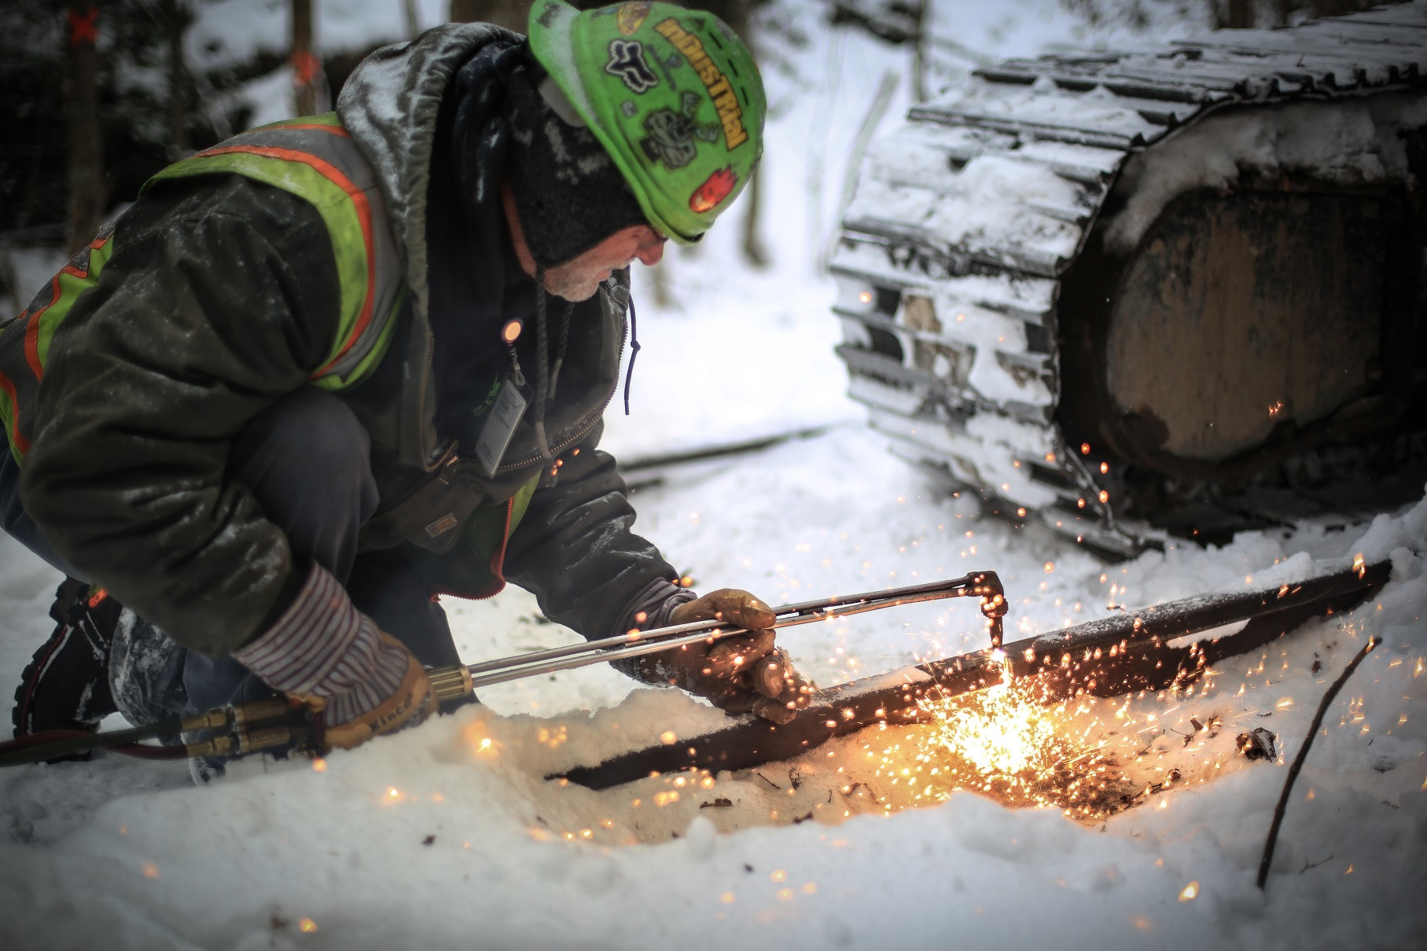
Ashokan Rail Trail
Phase 1: Railroad Track and Hazard Tree Removal

Slide 41
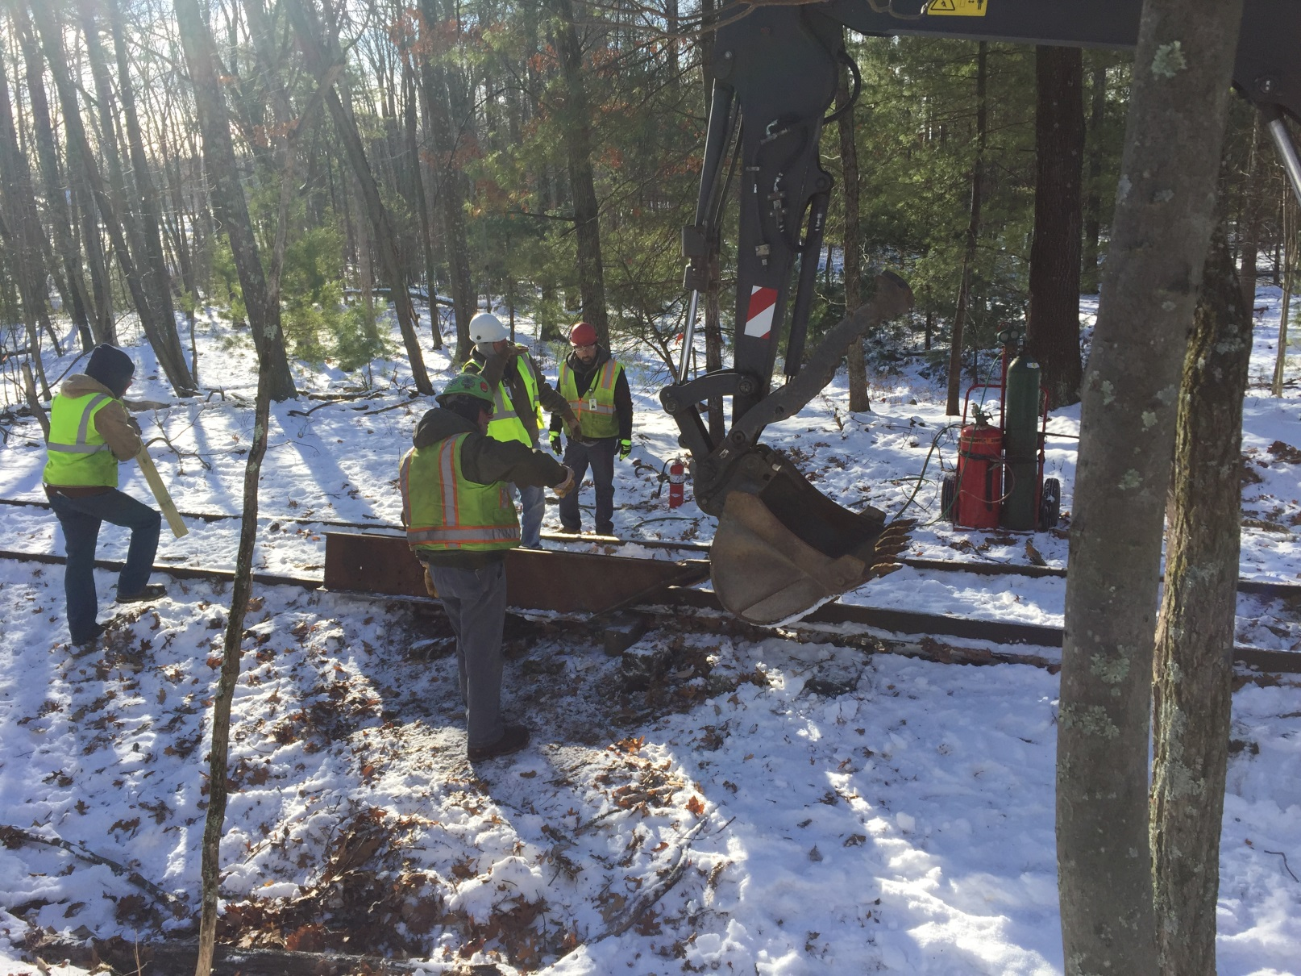
Ashokan Rail Trail
Phase 1: Railroad Track and Hazard Tree Removal

Slide 42
Ashokan Rail Trail
Phase 2: Trail And Butternut Bridge Construction
Phase 2 Began August 2018 – 60 Percent Complete
Construction of 11.5 Mile Crushed Stone Trail, including 520 ft. Boardwalk
Cleaning and Repair of 46 Drainage Culverts
Removal of Failed Butternut Creek Culvert and Replacement with 75 ft. Bridge
Installation of Safety Fencing, Benches, Signage, and Interpretive Displays
Completion by July 2019

Slide 43
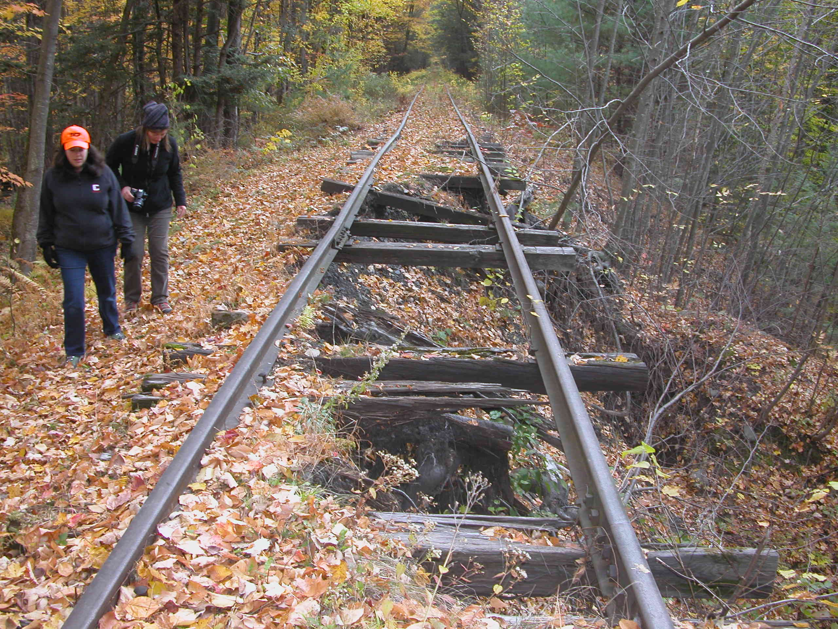
Ashokan Rail Trail
Phase 2: Trail And Butternut Bridge Construction

Slide 44
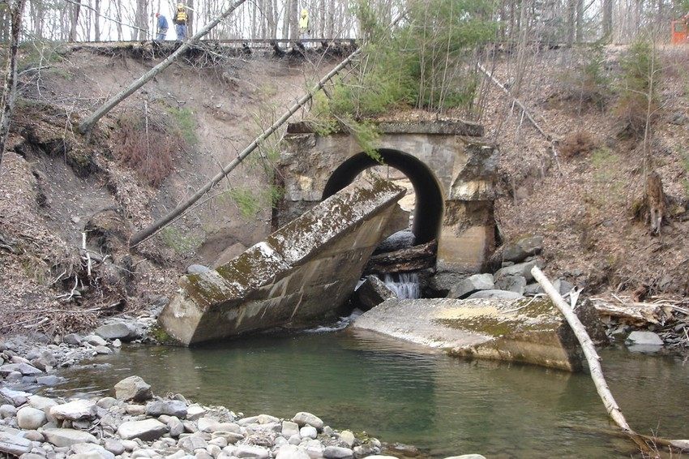
Ashokan Rail Trail
Phase 2: Trail And Butternut Bridge Construction

Slide 45
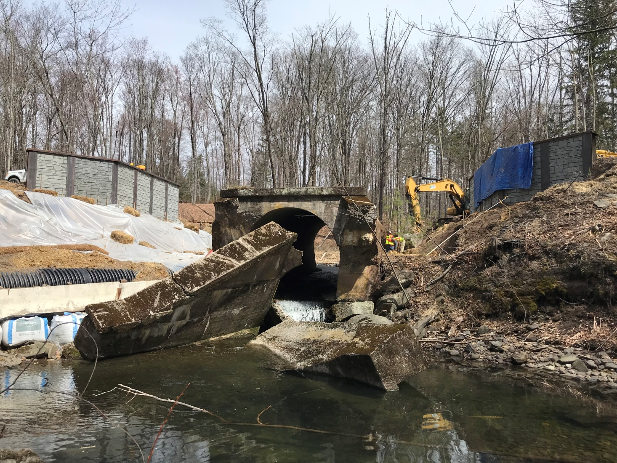
Ashokan Rail Trail
Phase 2: Trail And Butternut Bridge Construction

Slide 46
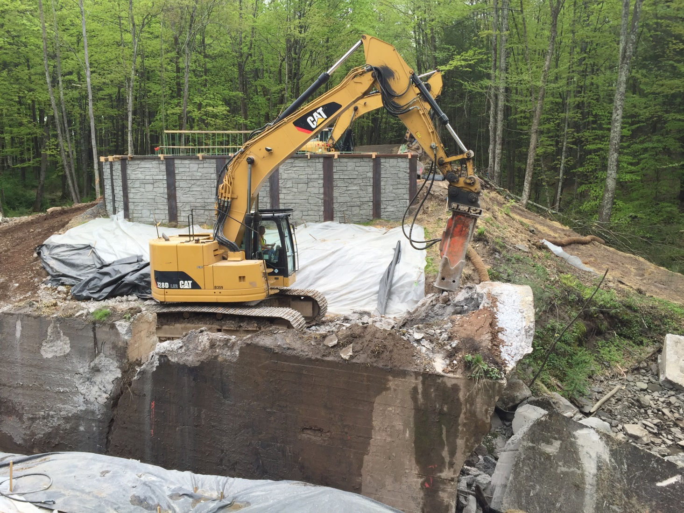
Ashokan Rail Trail
Phase 2: Trail And Butternut Bridge Construction

Slide 47
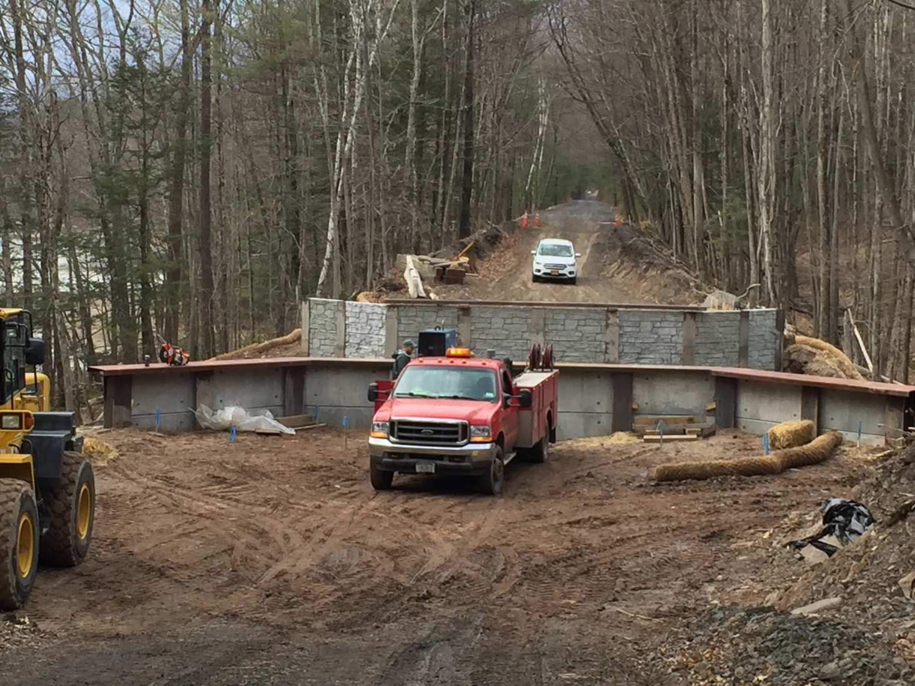
Ashokan Rail Trail
Phase 2: Trail And Butternut Bridge Construction

Slide 48
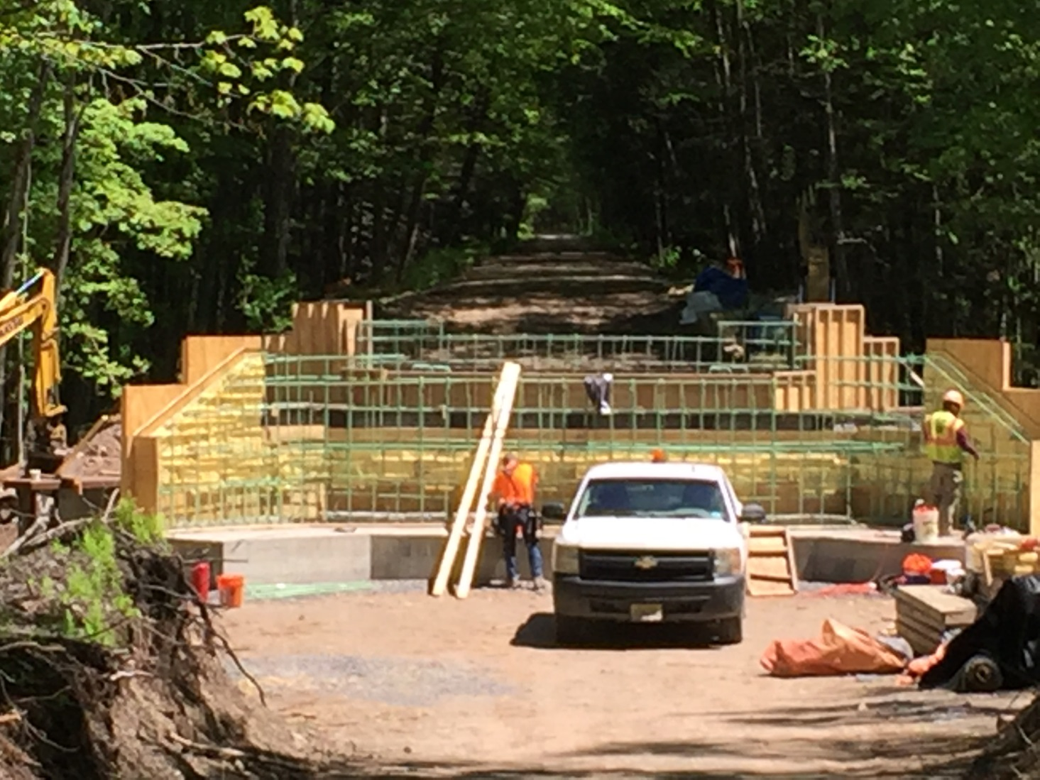
Ashokan Rail Trail
Phase 2: Trail And Butternut Bridge Construction

Slide 49
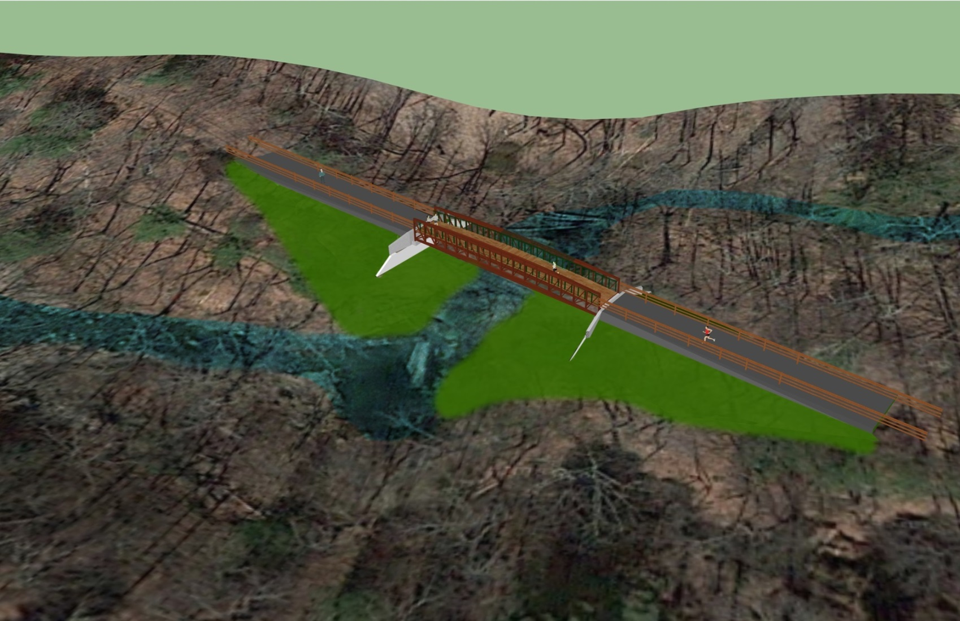
Ashokan Rail Trail
Phase 2: Trail And Butternut Bridge Construction

Slide 50
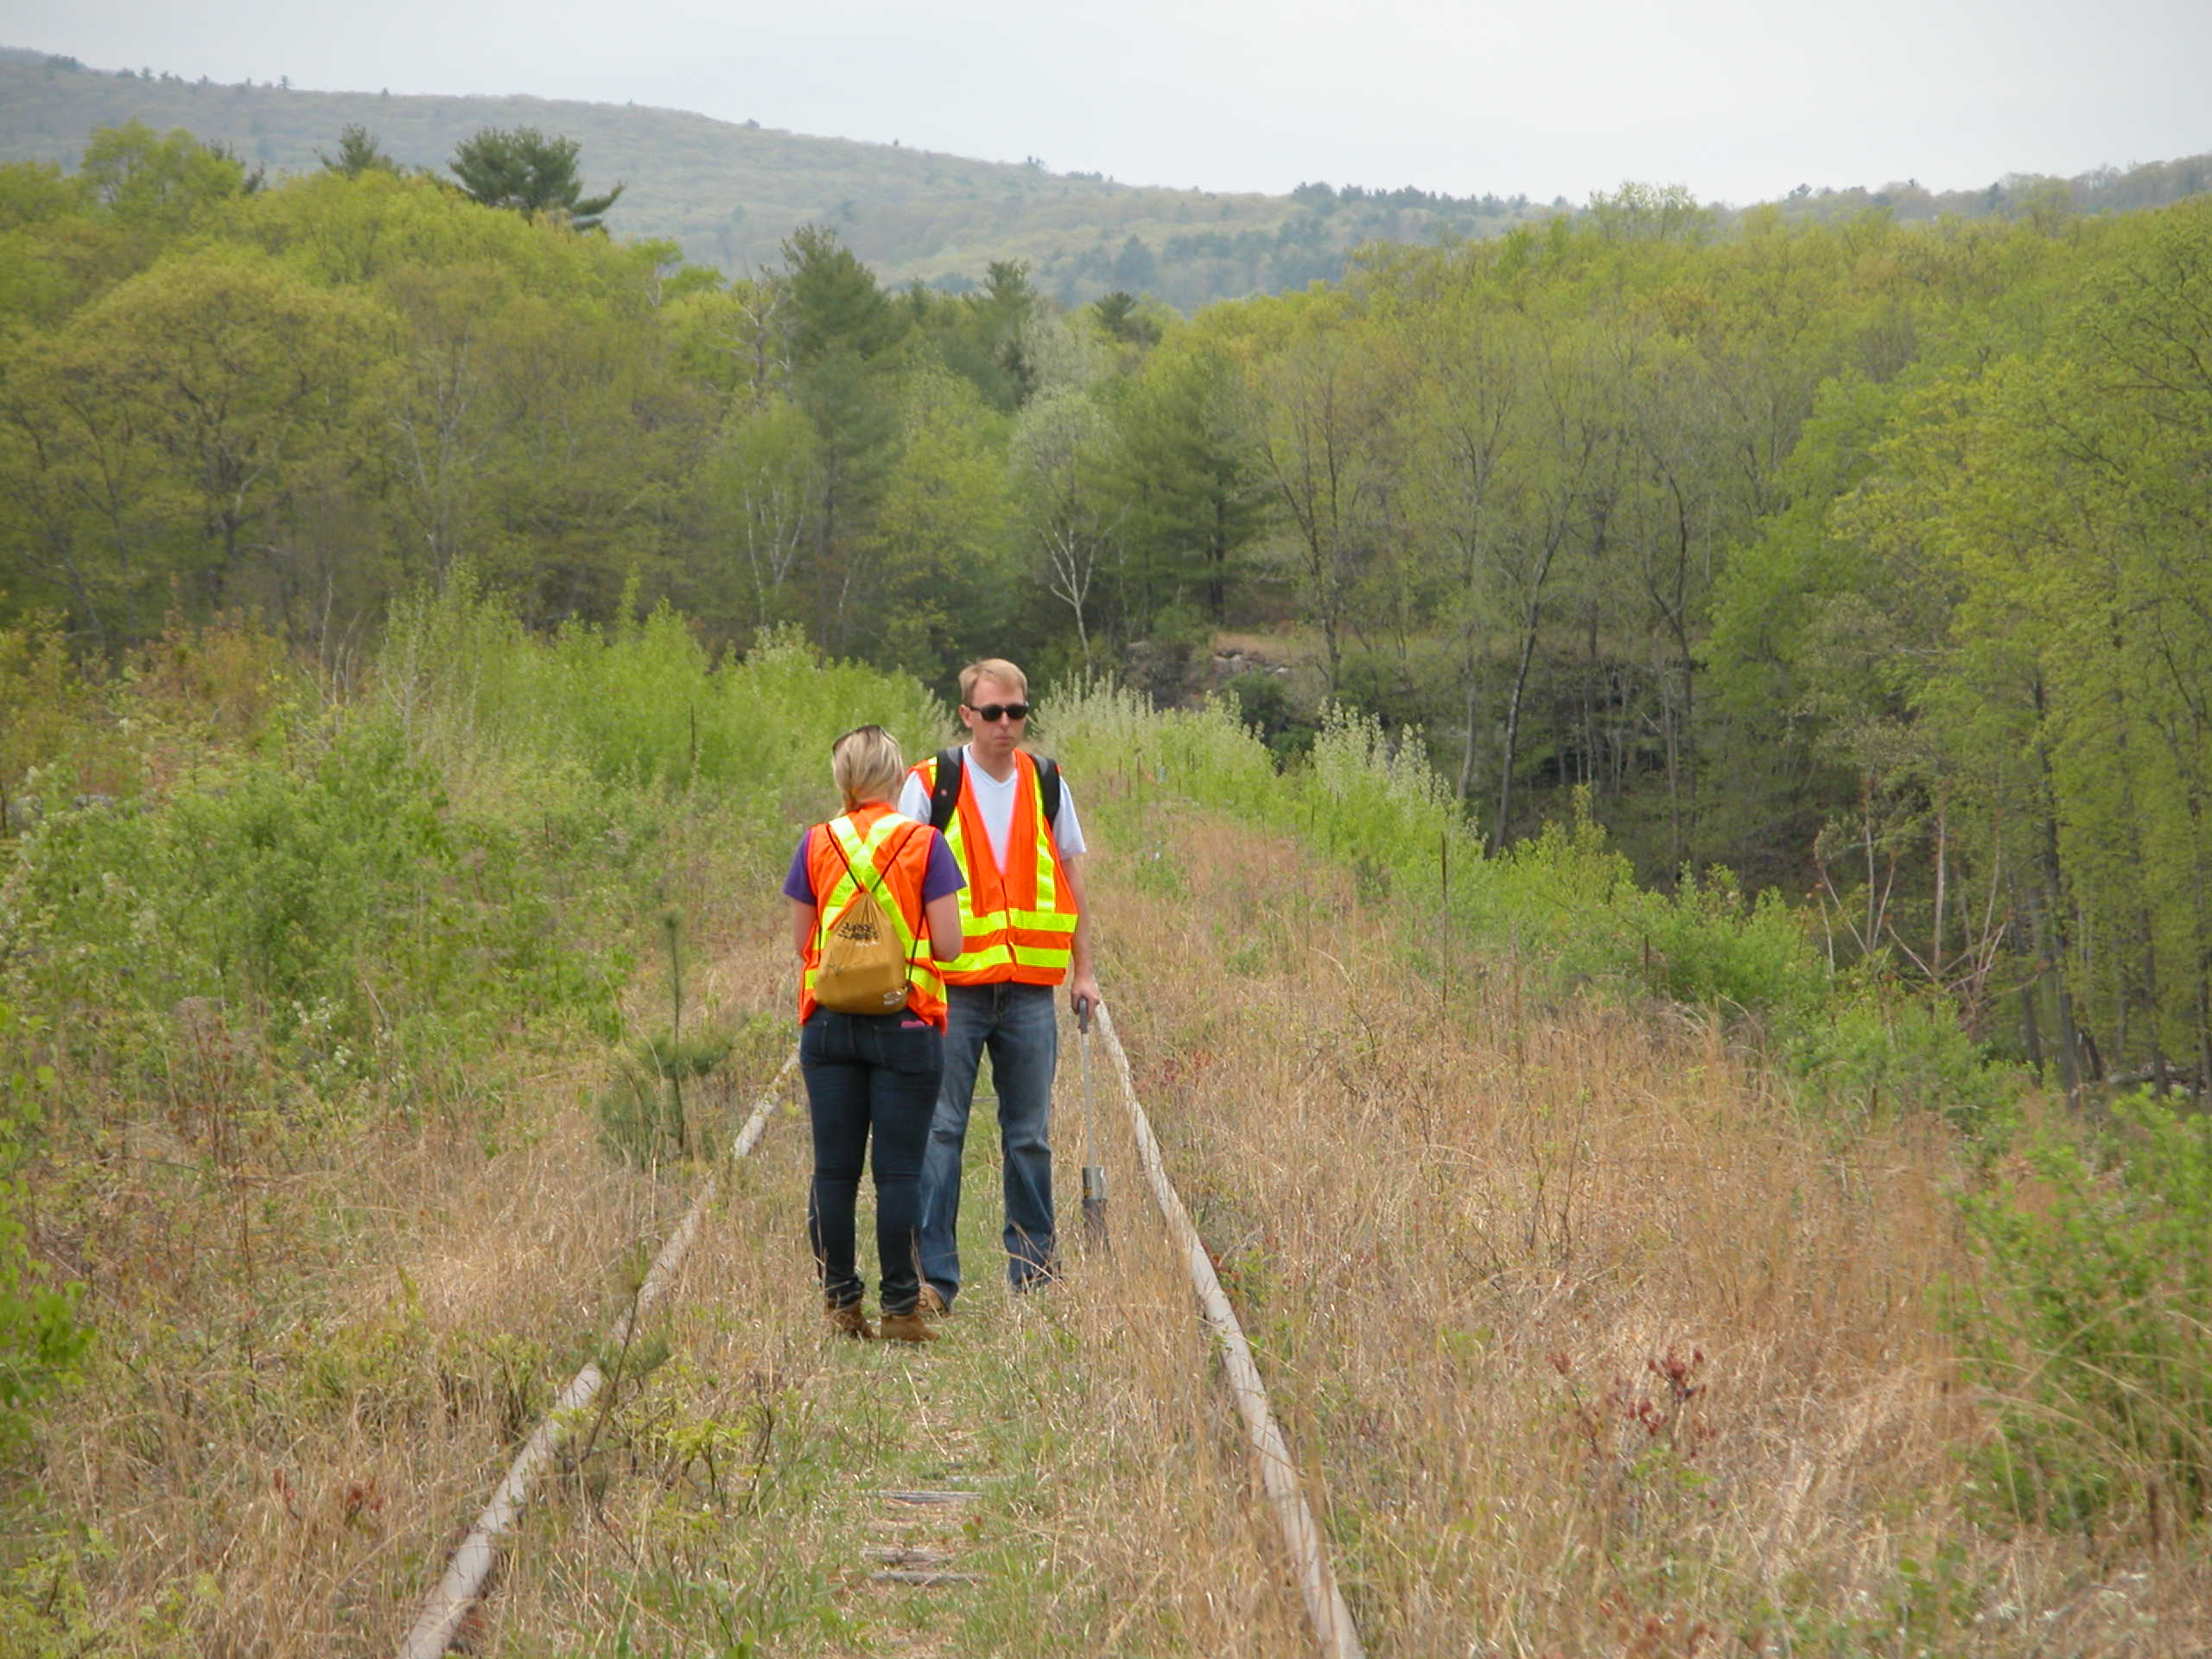
Ashokan Rail Trail
Phase 2: Trail And Butternut Bridge Construction

Slide 51
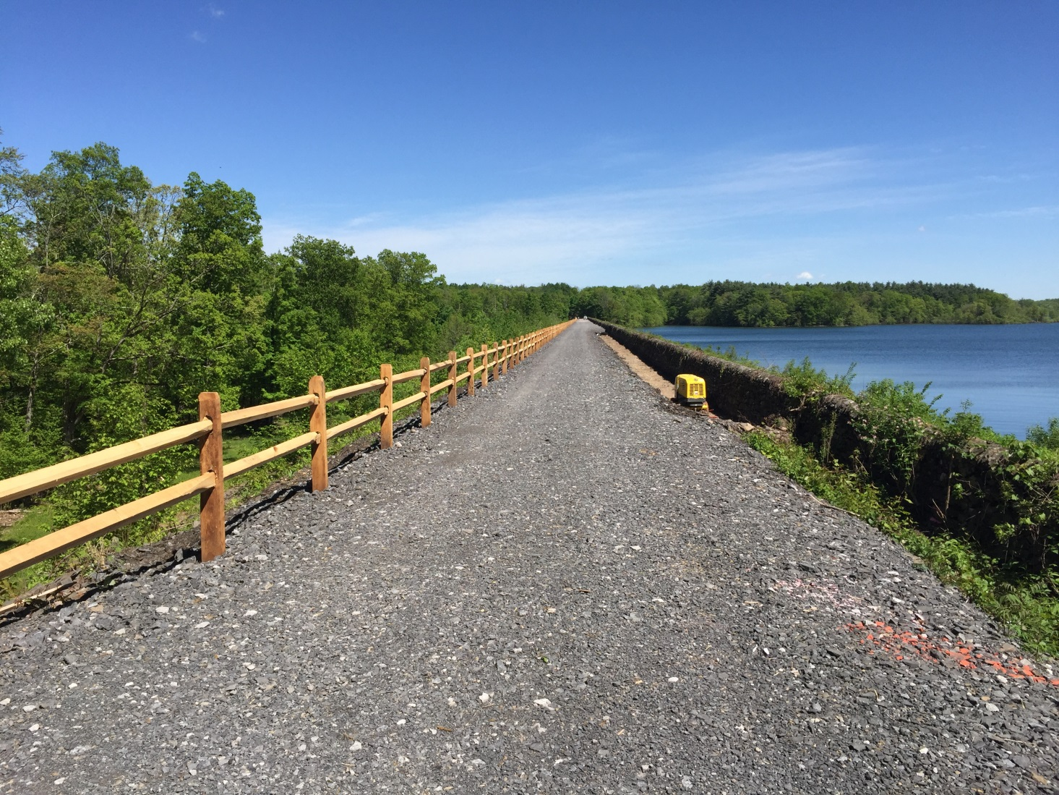
Ashokan Rail Trail
Phase 2: Trail And Butternut Bridge Construction

Slide 52
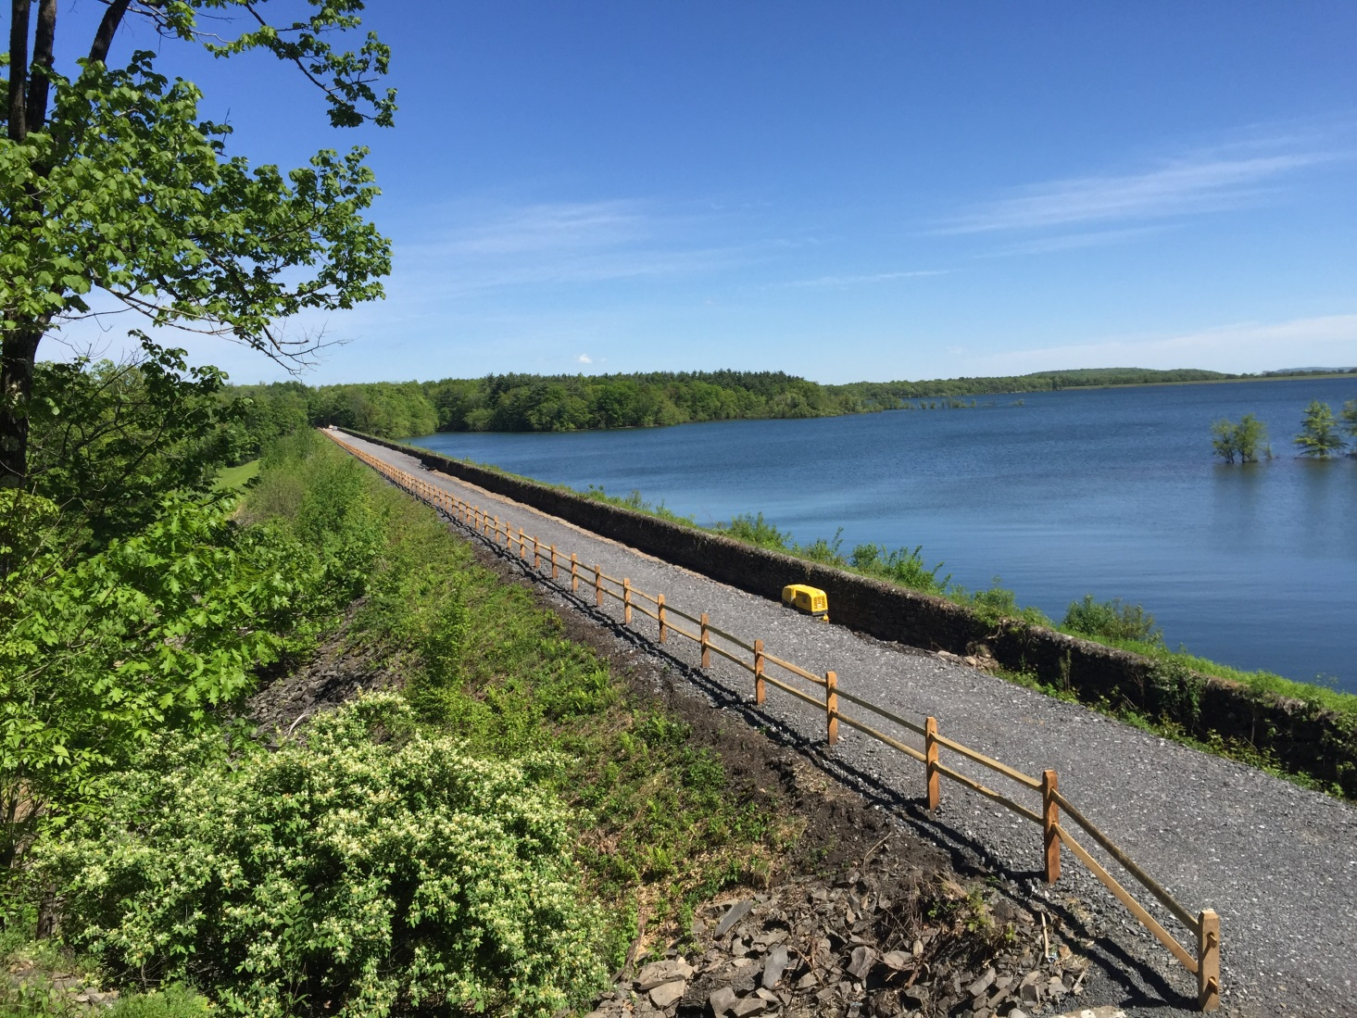
Ashokan Rail Trail
Phase 2: Trail And Butternut Bridge Construction

Slide 53
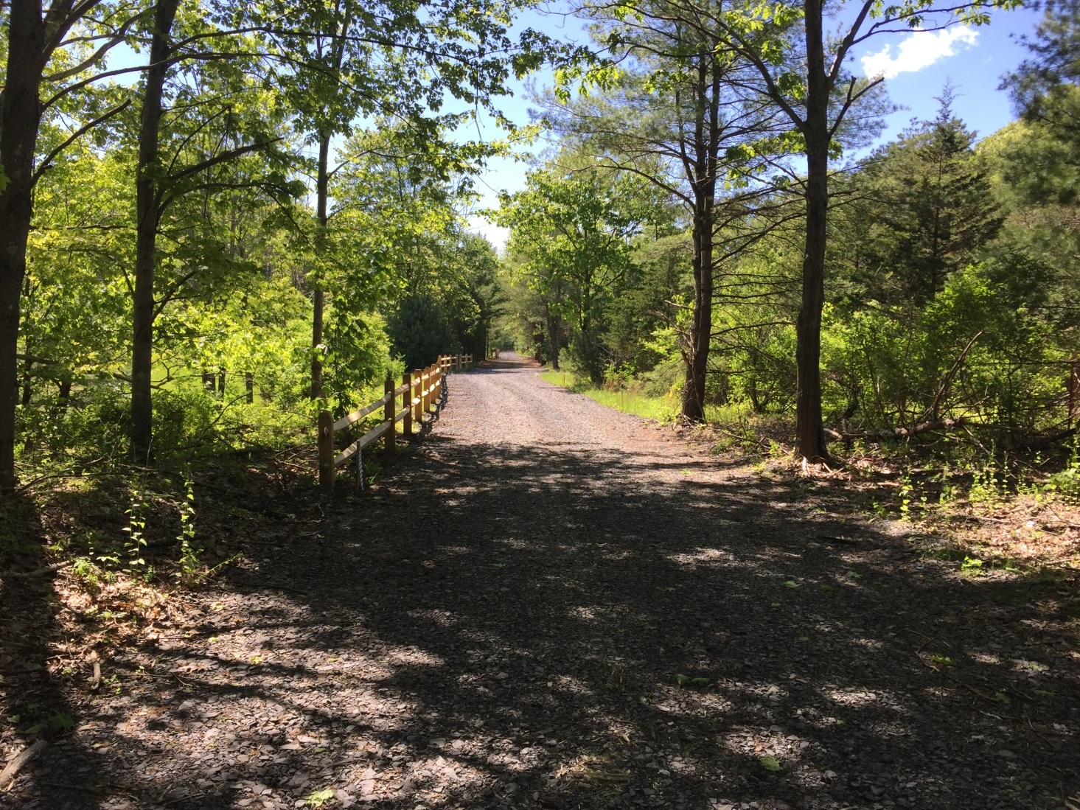
Ashokan Rail Trail
Phase 2: Trail And Butternut Bridge Construction

